Slide 1

Datascience 101
Georg Heiler | 01.12.19
Notes:
Georg (20 Vorlesungsstunden): - Wdh. was ist Data Science? - In Datenverarbeiten mit SQL, Python und R einsteigen - CRISP-DM - Ausblick auf Big Data, Spark etc. Prüfungsartefakte: - Hausarbeit bei Klaus - Präsentation / Referat bei Georg (mehrere Gruppen bilden und vorgegebenes Problem mit einer unterschiedlichen Sprache lösen lassen)

Slide 2
Agenda
Was ist Datascience?
Basics
GIT
Conda Environments
Docker
SQL & Relational Algebra
Regular-Expressions
Datascience lifecycle: CRISPDM hands-on project
Ausblick Bigdata (optional)

Slide 3
Georg Heiler @geoHeil
Co-founder of startup for time series prediction
Data scientist @MagentaTelekom fraud prediction & big geospatial analytics
Lecturer & Speaker
Organizing data science meetups in Vienna Data Science Group (VDSG) & board member (and international Frankfurt, Belgrade, …)
PhD candidate @Complexity Science Hub
Notes:
Board member VDSG

Slide 4
Prüfungsmodalitäten
Gruppenarbeit
Präsentation jeweils Ende des Tages . Teamgröße: 3 Personen / Max 8 Min + 3 Min Diskussion
Jede Gruppe wird an anderen Datensets arbeiten
Kurs behandelt exemplarisch Python. Gruppenarbeiten in anderen Sprachen (Scala, R, Julia, Knime, ….) sind willkommen. Aber erfordern ggf. zusätzliche Initiative
Notes:
Slides auf Englisch sobald es um Inhalte geht / Kurs auf Deutsch
Bescheid sagen wenn zu flott / etwas im Detail erklärt werden muss

Slide 5
Software Requirements
Docker
Conda
Texteditor freier Wahl, Visual Studio Code ist empfohlen
GIT
Optional SQL Tool of choice (Datagrip recommended, free EDU license available)
Optional JDK8 (if you want to use JVM tools or we work on big-data related exercises)
Notes:
Wer hat das schon installiert?

Slide 6
Recommended reading
check out https://github.com/geoHeil/awesome-tools and star it if you like it
Handbuch Data Science: Mit Datenanalyse und Machine Learning Wert aus Daten generieren
http://faculty.marshall.usc.edu/gareth-james/ISL/
https://dataintensive.net
https://r4ds.had.co.
https://www.amazon.de/dp/B07L9JDXM8/
https://www.oreilly.com/library/view/high-performance-spark/9781491943199/
https://therinspark.com/intro.html#intro-background
http://www.sqlservercentral.com/stairway/72400/
Online Sql Tutorials
http://www.sql-lessons.com/
http://www.1keydata.com/sql/sql.html (take the test!)
https://www.w3schools.com/sql/default.asp
https://medium.freecodecamp.org/the-rise-of-the-data-engineer-91be18f1e603
Python Data Science Handbook
https://github.com/fastai/numerical-linear-algebra/blob/master/README.md
Introduction to machine learning for coders - fastAi http://course18.fast.ai/ml
https://www.fast.ai/2019/07/08/fastai-nlp/
practical deep learning for coders https://course.fast.ai
http://faculty.marshall.usc.edu/gareth-james/ISL/
https://www.math3ma.com/blog/matrices-probability-graphs
https://medium.com/deliberate-data-science/so-you-want-become-a-data-science-manager-4ff9544e6827
https://medium.com/baseds/scalability-growing-a-system-in-different-directions-ae16469c4cb3
https://veekaybee.github.io/2019/02/13/data-science-is-different/
https://caitlinhudon.com/2018/11/28/git-sql-together/
https://dataengweekly.com
http://datasciencemasters.org/
http://data8.org/
https://www.cs.cornell.edu/jeh/book%20no%20so;utions%20March%202019.pdf
https://web.stanford.edu/~hastie/ElemStatLearn/
https://chartio.com/blog/cloud-data-management-book-launch/
https://dataschool.com/books/
https://developers.google.com/machine-learning/guides/rules-of-ml
https://www.cs.princeton.edu/~arvindn/talks/MIT-STS-AI-snakeoil.pdf
https://textbooks.math.gatech.edu/ila/
http://pythontutor.com/
https://explained.ai/matrix-calculus/index.html
Notes:
Vieles
Ein paar gute Bücher. Überblick (2x cloud data management, handbuch data science)
Gute Ratschläge
Referenzen
Mathematik Auffrischung
MOOCS
take your time - really recommended to read them.

Slide 7
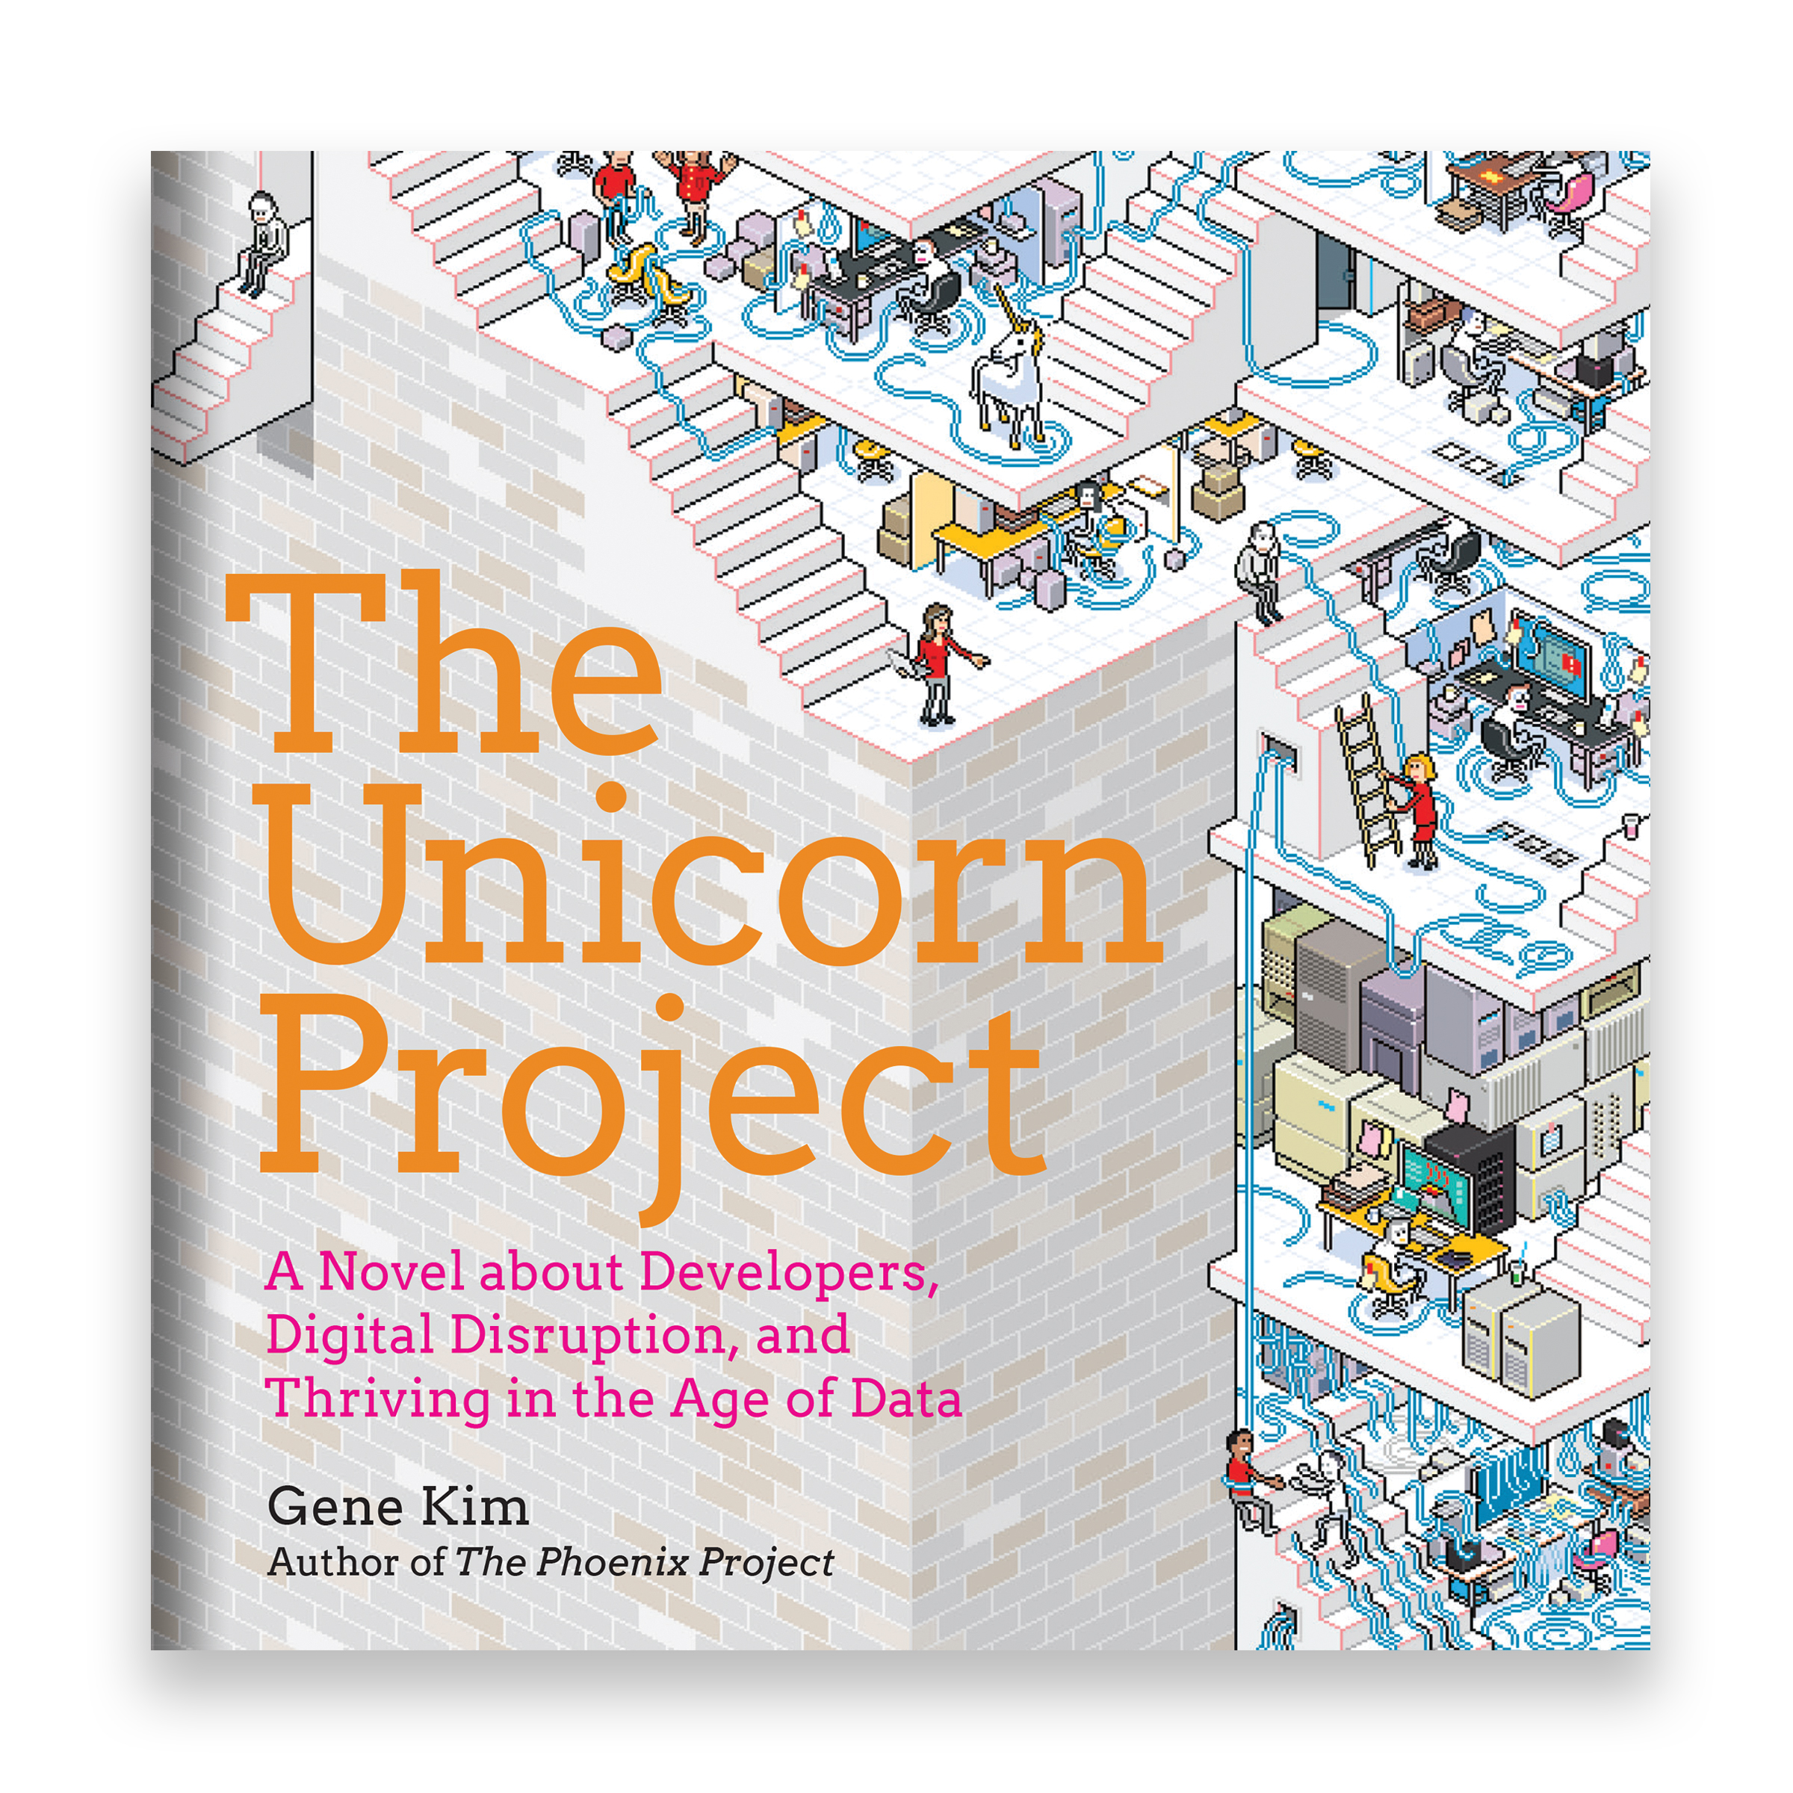
There is more to Data Science than only data & science
Any large corporate will apply data science methods in their innovation projects
Change management
People
Politics
Facilitating innovation and convincing leaders
https://itrevolution.com/the-unicorn-project/
Notes:
we will mostly look at the easy part (=technology) but in reality there is so much more to working in innovation.

Slide 8
Danksagung für Unterstützung bei Materialien
Allan Hanbury
Mohamed Auf
Andrew Poulter

Slide 9

github.com/lecturing/DHBW19-DS101
Slides
Notes:
Link dazu auch im Moodle

Slide 10
What is data science
Introduction Part 1
Notes:
Kurze Weiderholung: Was ist Datenanalyse

Slide 11

Data Science: To gain insights into data through computation, statistics, and visualization
Notes:
Commonly found definition

Slide 12

We leave traces when we interact with internet services
Notes:
Große Internet Service Firmen und Soziale Medien Firmen verwenden die Datenspuren, die wir hinterlassen, sehr effizient.
Oft sind wir bereit, diese Daten herzugeben, weil es uns Vorteile bringt.
Google

Slide 13
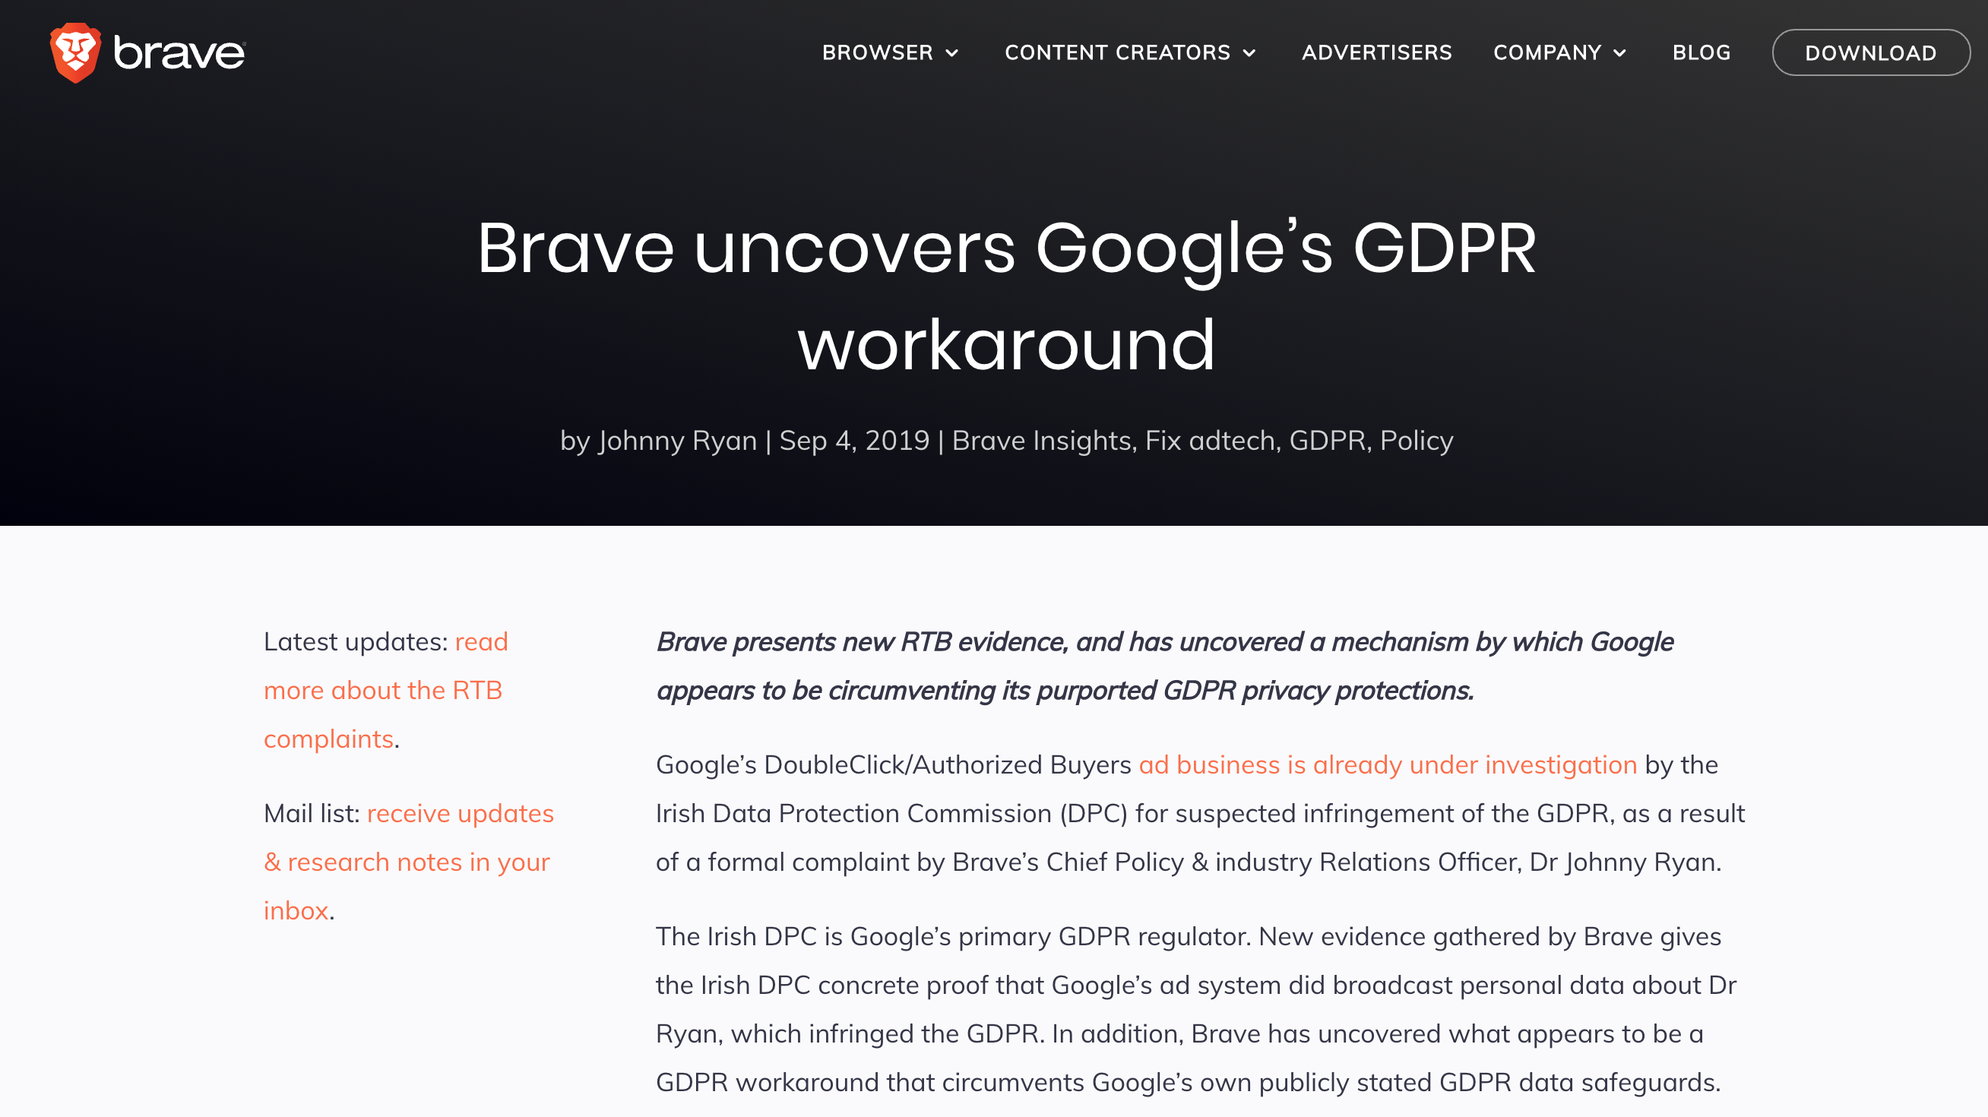
Notes:
https://brave.com/google-gdpr-workaround/

Slide 14
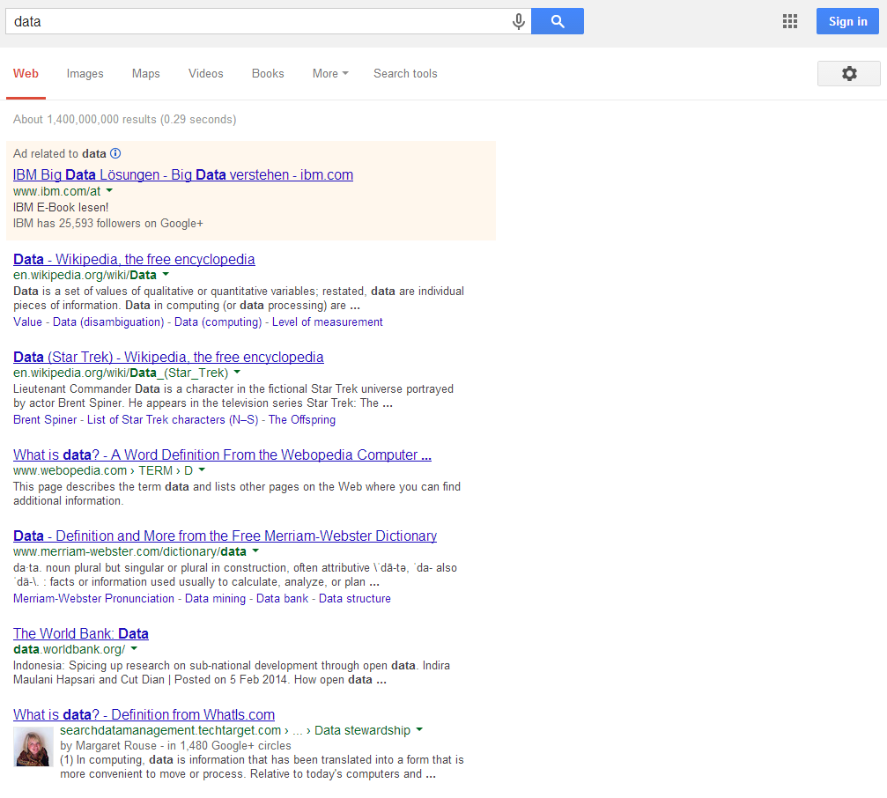
Not logged in
Notes:
Hier sind die „nicht eingeloggten“ Suchergebnisse für die Suchanfrage „Data“. Sie sind ziemlich generell.

Slide 15
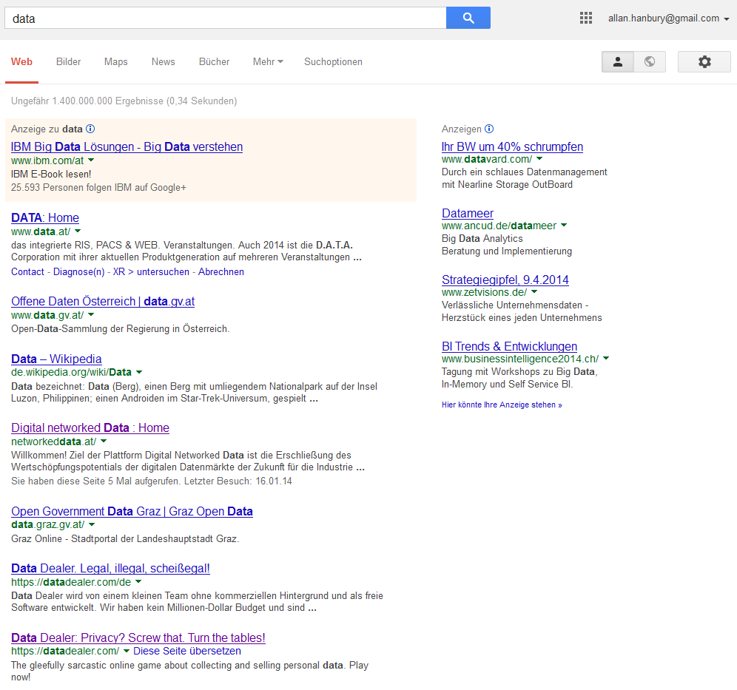
Logged in
Notes:
Einmal eingeloggt, sind die Ergebnisse gut personalisiert. Weil ich meine Suchdaten zur Verfügung stelle, kann ich meine Suchaufgaben effizienter erledigen.

Slide 16
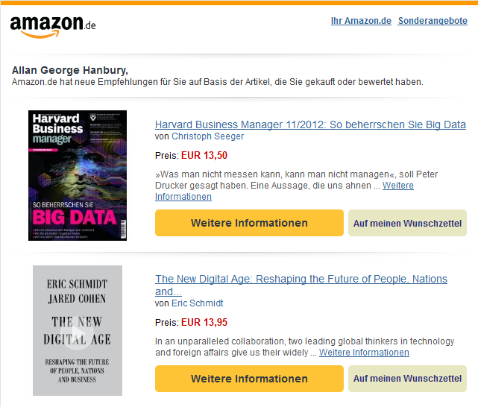
Notes:
Weil online Geschäfte Informationen über alle Einkäufe gespeichert haben, sind die Vorschläge meist sehr passend.
Negativbeispiel: Kindle Einkauf

Slide 17
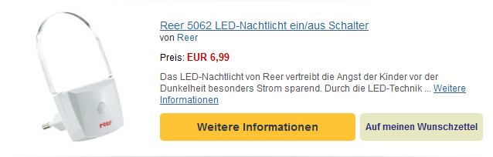
Notes:
Aber alle Vorschläge sind nicht nützlich. Wenn ich einmal ein Nachtlicht gekauft habe, bedeutet es nicht, dass ich ein Nachtlicht von einer anderen Marke kaufen will.

Slide 18
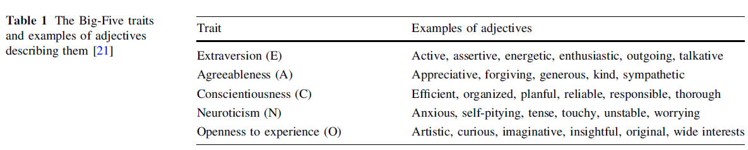
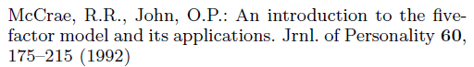
Predicting personality
Notes:
Preparation Elections

Slide 19

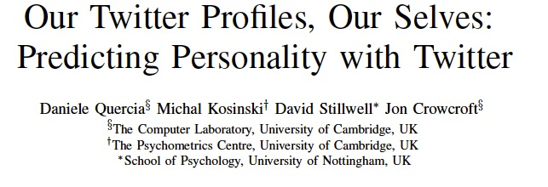
Notes:
Preparation Elections

Slide 20
Influencing Elections
“…that was just one of several ways that Mr. Obama’s campaign operations, some unnoticed by Mr. Romney’s aides in Boston, helped save the president’s candidacy. In Chicago, the campaign recruited a team of behavioral scientists to build an extraordinarily sophisticated database …that allowed the Obama campaign not only to alter the very nature of the electorate, making it younger and less white, but also to create a portrait of shifting voter allegiances. The power of this operation stunned Mr. Romney’s aides on election night, as they saw voters they never even knew existed turn out in places like Osceola County, Fla.”
New York Times, Wed Nov 7, 2012

Slide 21
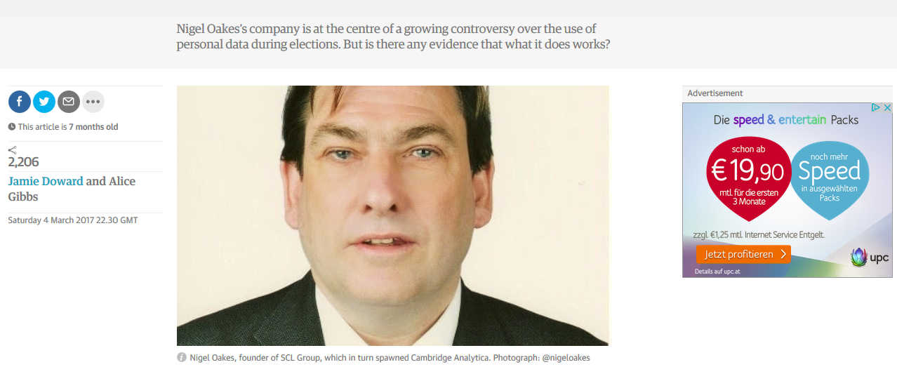
https://www.theguardian.com/politics/2017/mar/04/nigel-oakes-cambridge-analytica-what-role-brexit-trump
Notes:
Databreach camebridge analytica?
Breites Feld,
Legal wichtig

Slide 22

Data scientist
Notes:
Who wants to be a data scientist?
Why do you want to be a data scientist?
Who knows what a data scientist is?
What is a data scientist?

Slide 23

Data Scientist
“A data scientist is someone who knows more statistics than a computer scientist and more computer science than a statistician.”
Joshua Blumenstock
Notes:
Zwischen den Stühlen
Eierlegende Wollmilchsau
Unicorn?
Team Player zur Umsetzung zwingend notwendig

Slide 24
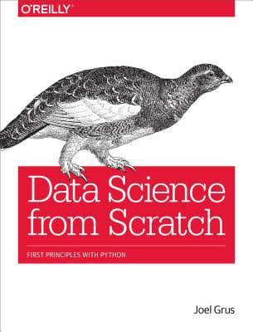
Data Scientist
“A data scientist is someone who extracts insights from messy data.”

Slide 25

Data Scientist Venn Diagram
Drew Conway: http://drewconway.com/zia/2013/3/26/the-data-science-venn-diagram

Slide 26
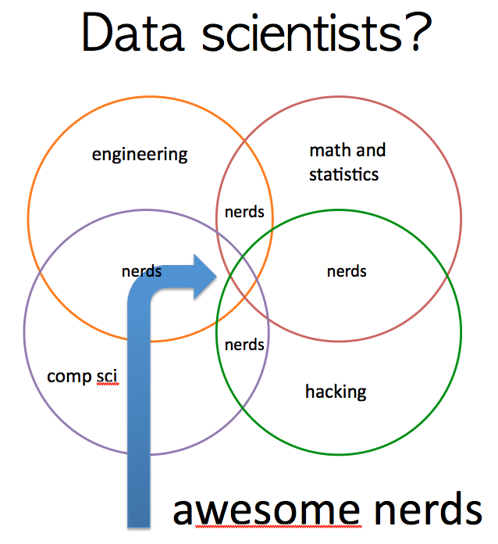
Hilary Mason: https://www.forbes.com/sites/danwoods/2012/03/08/hilary-mason-what-is-a-data-scientist/#2c63f0685502
Notes:
Don‘t forget the data engineers!!!
Machine learning engineers

Slide 27
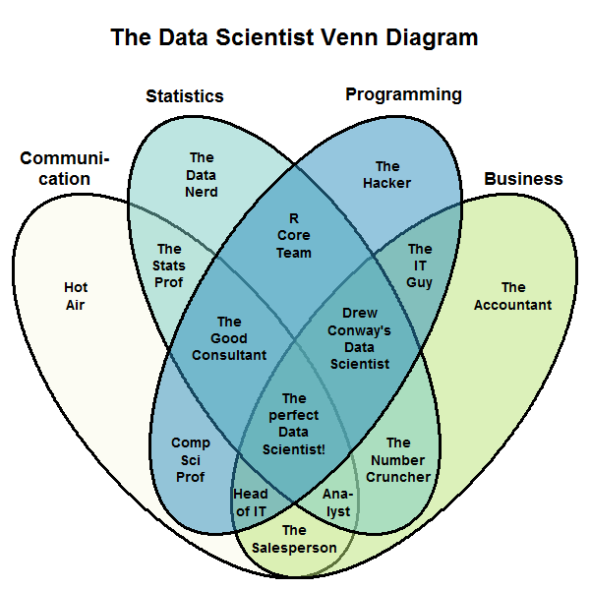
Stephan Kolassa: http://www.kdnuggets.com/2016/10/battle-data-science-venn-diagrams.html/2

Slide 28
data scientist vs. data engineer
Notes:
What you do toatally depends on the size and maturity of the company / project you are working in

Slide 29
Data science is different now
Unrealistic expectations: machine learning, deep learning, and Bayesian simulations
“data science” has never been as much about machine learning as it has about cleaning, shaping data, and moving it from place to place.
https://veekaybee.github.io/2019/02/13/data-science-is-different/

Slide 30
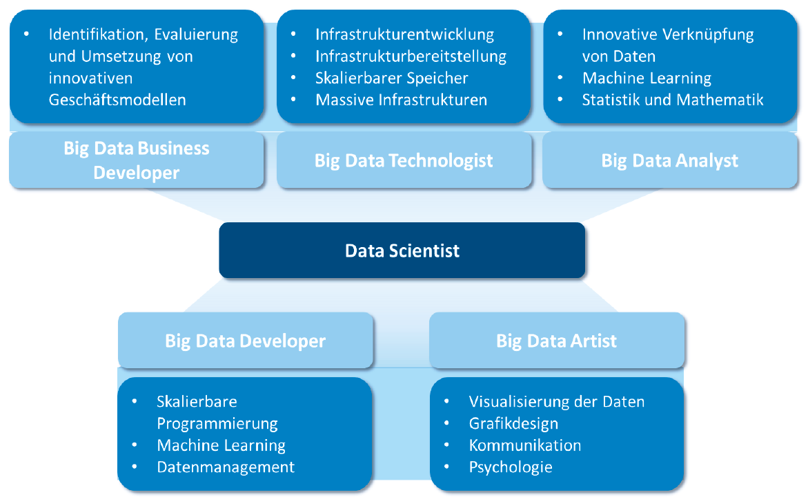
Data Science as Team Work
Identifying, evaluating and implementing innovative business models
Infrastructure development
Infrastructure provision
Scalable memory
Massive infrastructure
Innovative fusion of data
Machine Learning
Statistics and Mathematics
Scalable programming
Machine Learning
Data management
Data visualisation
Graphic design
Communication
Psychology
https://www.data.gv.at/katalog/dataset/big-data-in-austria-osterreichische-potenziale-und-best-practice-fur-big-data/resource/7c5db11e-249c-44bc-a203-a2a317e1b90a
Notes:
Unicorn
Erwartungen von Firmen
Eierlegende Wollmilchsau
Trend zu ML Ops

Slide 31
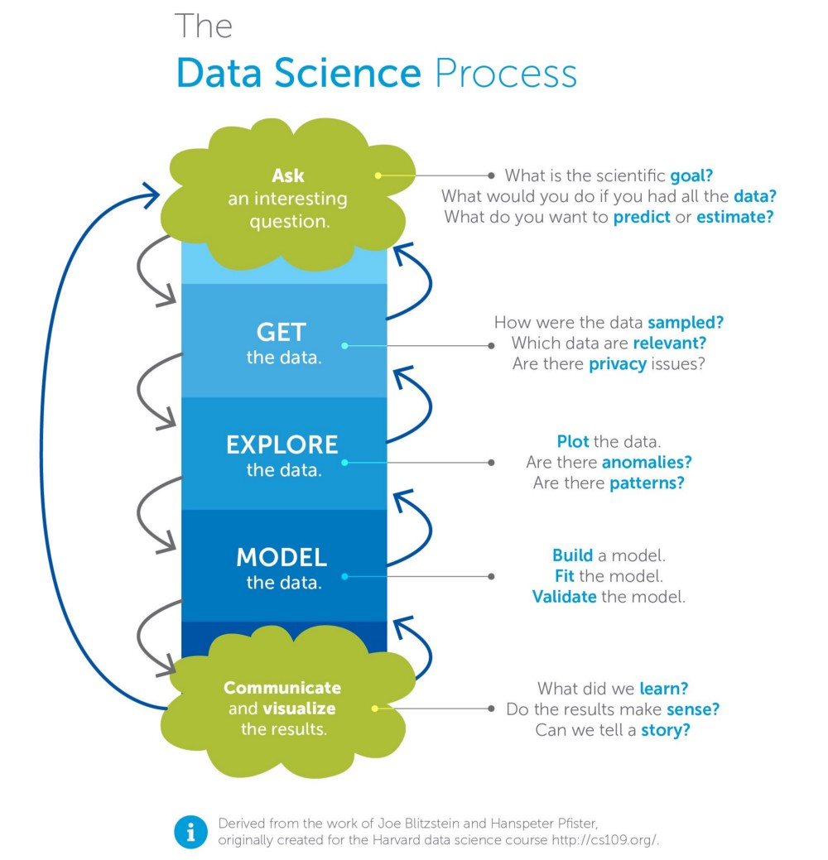
Notes:
Nicht nur Science (herumprobieren) sondern auch Zielorientiert (business, Prozess)

Slide 33
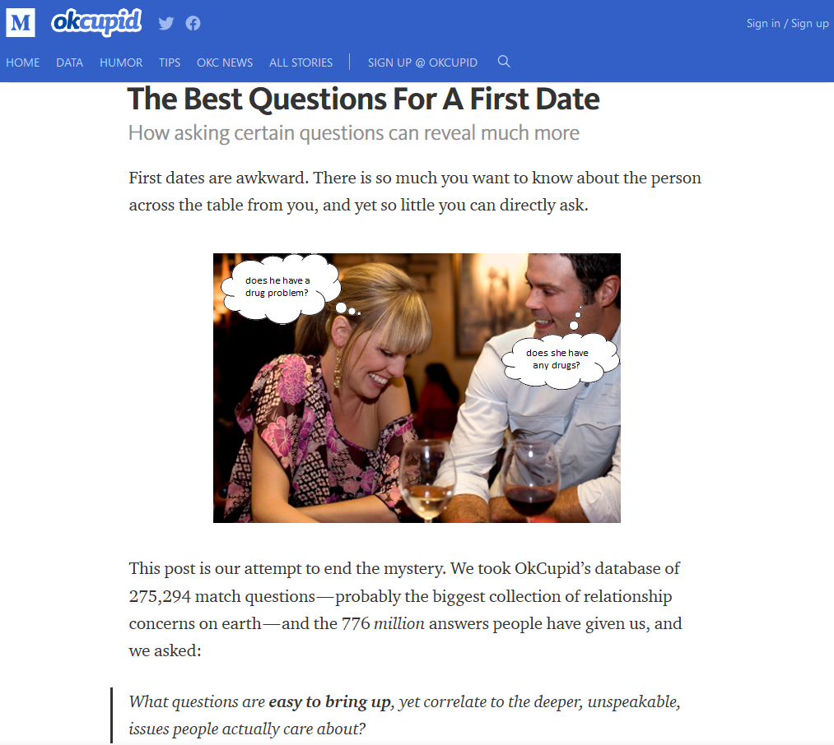
https://theblog.okcupid.com/the-best-questions-for-a-first-date-dba6adaa9df2
Notes:
Die richtigen Fragen stellen

Slide 34
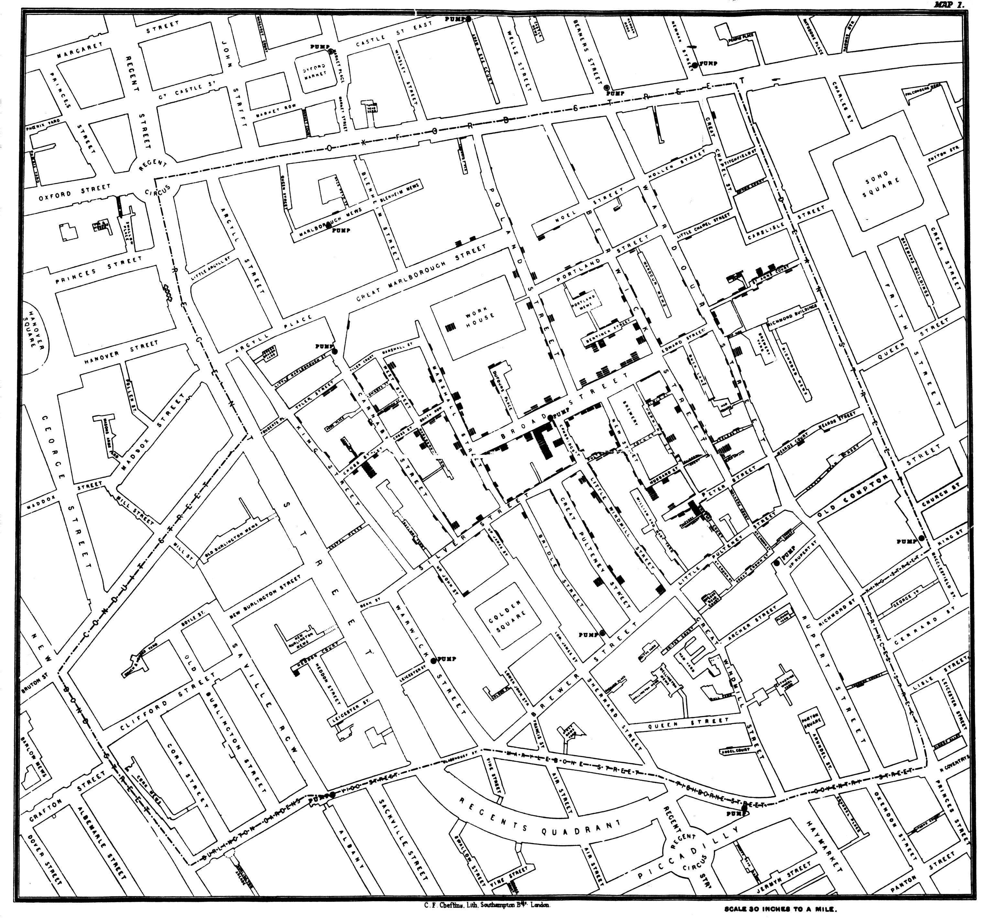
Correlation by John Snow, 1854
Notes:
- Korrelation wird seit langem gemacht.
- 1854
- Historische Korrelation: John Snow Cholera Todesfälle
- Brauerei

Slide 35

https://xkcd.com/552/

Slide 36
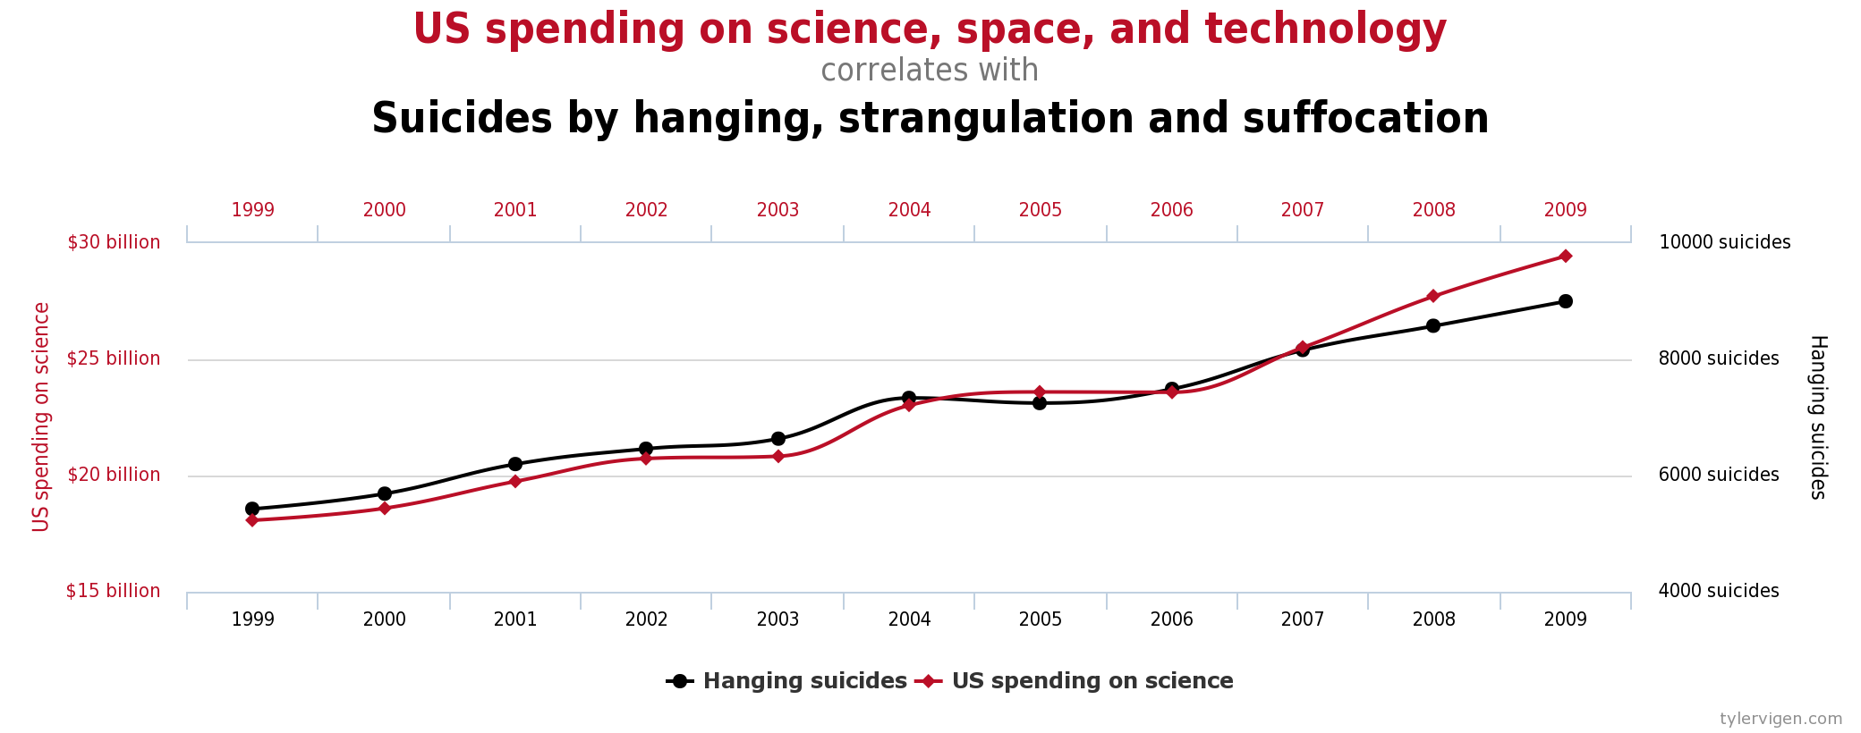
Correlation: 0.9979
http://tylervigen.com
CC BY 4.0
Notes:
Aber nicht alle Korrelationen sind sinnvoll. Hier ist ein Beispiel mit sehr hohe Korrelation
US Ausgaben für Wissenschaft, Raumfahrt und Technologie
Selbstmorde durch Erhängen, Strangulation und Ersticken

Slide 37
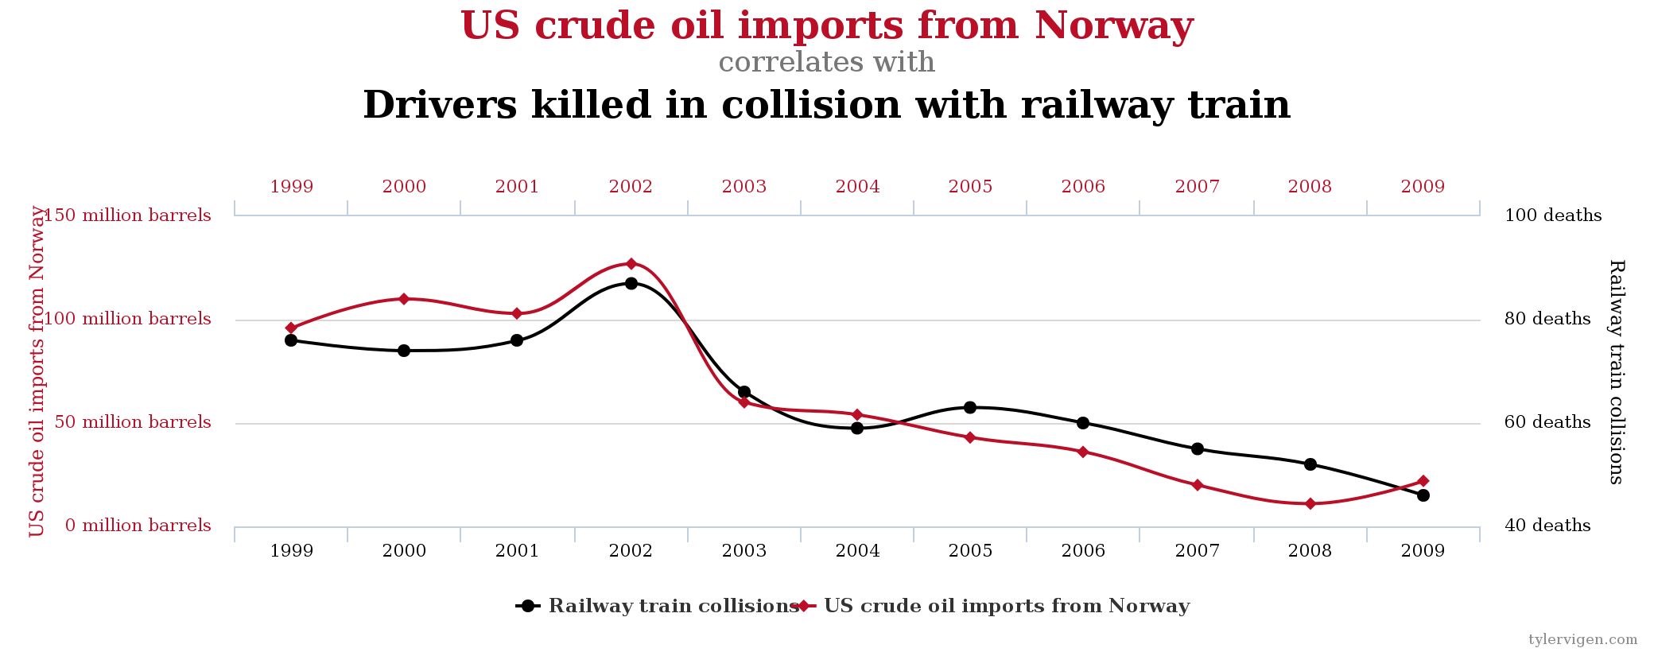
Correlation: 0.9545
http://tylervigen.com
CC BY 4.0
Notes:
Erdöl Importe aus Norwegen
Fahrer in Zusammenstößen mit Zügen getötet.
Während der Hype ist oft gesagt worden, dass nur viele Daten und Korrelationen notwendig sind. Aber Hypothesen und Vernunft sind auch noch notwendig.

Slide 39
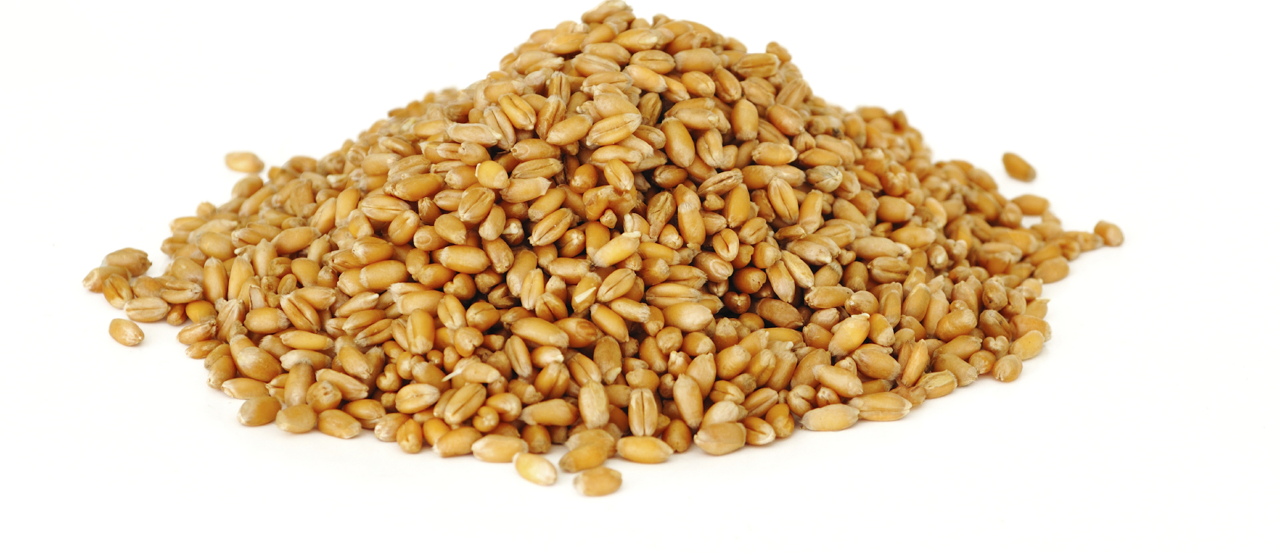
Notes:
Statt Stichproben auf dem Silbertablett

Slide 40
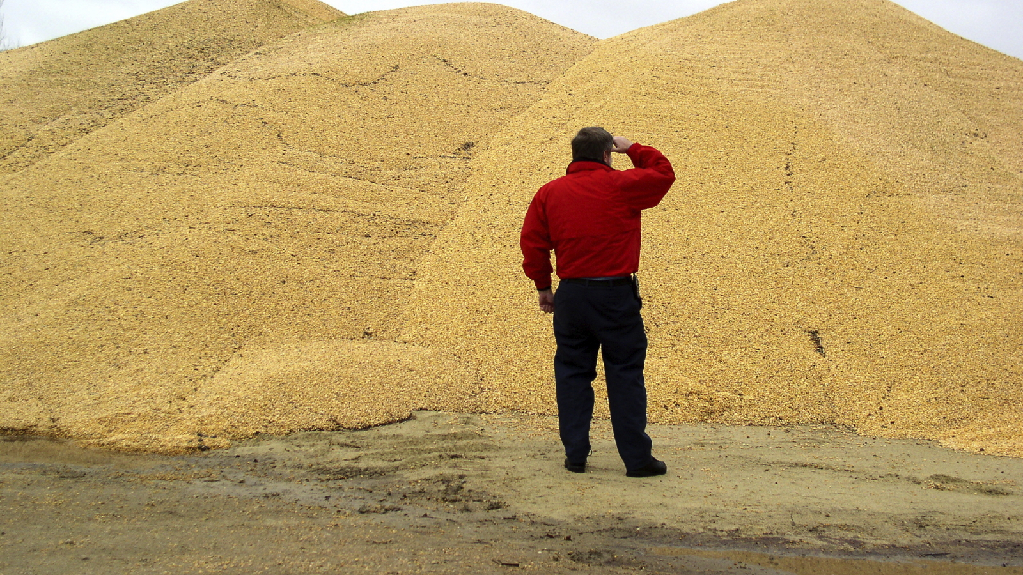
Notes:
Werden fast alle Daten gesammelt (bspw. Supermärkte).
Organisationen haben viele Daten - Datenhaufen. Aber nur Daten zu besitzen ist nicht ausreichend, die Daten sollen Mehrwert erzeugen. Was wird mit den Daten gemacht?
Was ist der Unterschied zu früher? Jetzt ist es möglich, „alle“ Daten zu bearbeiten, weil Rechnerleistung und Speicherplatz vorhanden sind.
Das ist immer eine Lüge. Daten werden sich über kurz oder Lang nur speichern lassen wenn ein Business Need dahinter ist!

Slide 41
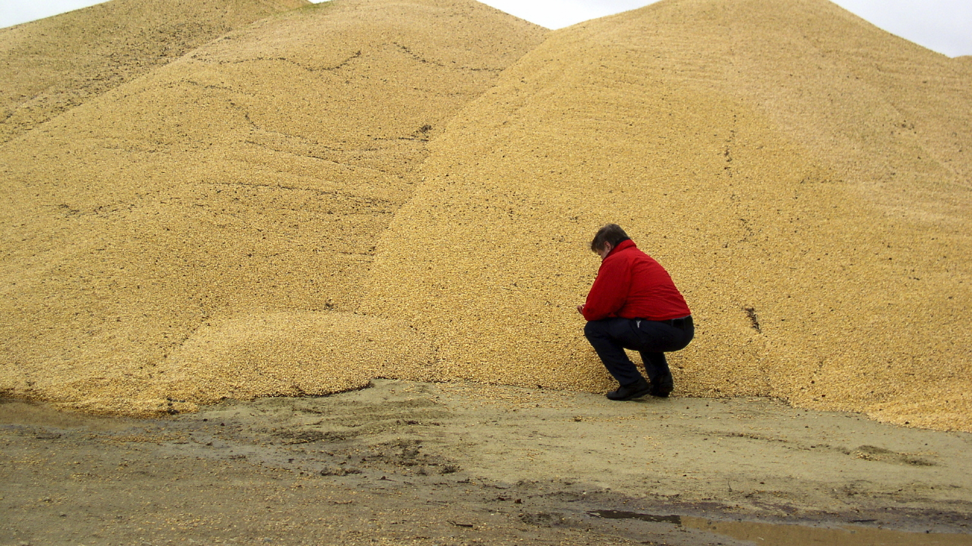
Notes:
Das Problem mit vielen Daten ist aber, wenn man beginnt sie zu bearbeiten, kommt man schnell drauf, dass es eher…

Slide 42
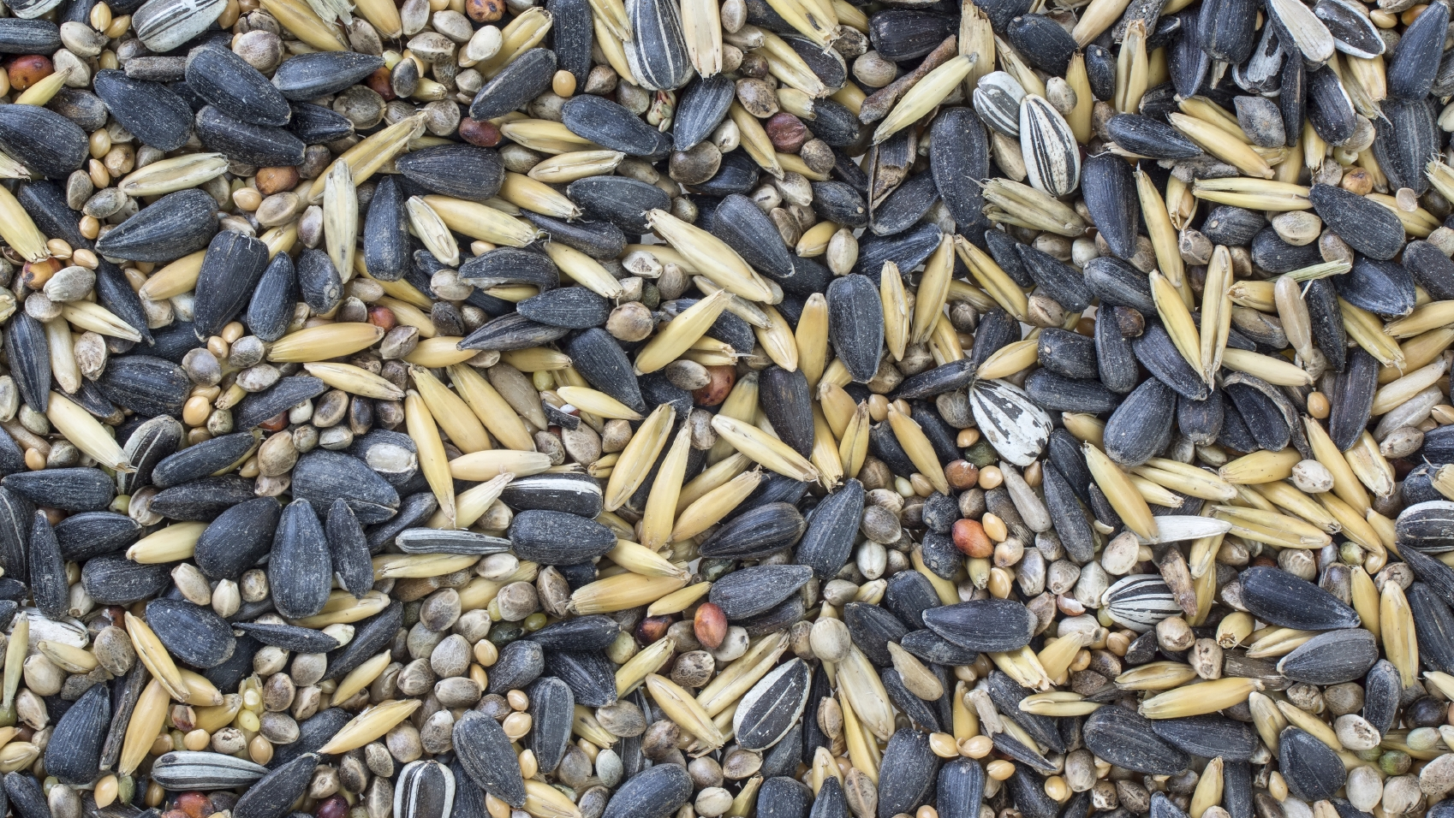
Up to 80% of time used for data cleaning
Notes:
so aussieht…
Die Daten sind aus unterschiedlichen Quellen, in unterschiedlichen Formaten, sie sind teils strukturiert, teils unstrukturiert und unvollständig.
Oft gehen 50-80% der Datenanalyse-Arbeit in die Bereinigung und Zusammenlegung von Daten.

Slide 43
Types of Data
Structured
Unstructured
Natural language
Machine-generated
Graph-based
Audio, video, and images
Streaming
D. Cielen, A. D. B. Meysman, M. Ali, Introducing Data Science, Manning, 2016.

Slide 44
Structured Data
Depends on a data model
Resides in a fixed field within a record
Often stored as tables within databases or Excel files
SQL (Structured Query Language) usually used to manage and query structured data
Hierarchical data (e.g. family tree) is structured, but not easy to put into a database or Excel
D. Cielen, A. D. B. Meysman, M. Ali, Introducing Data Science, Manning, 2016.

Slide 45
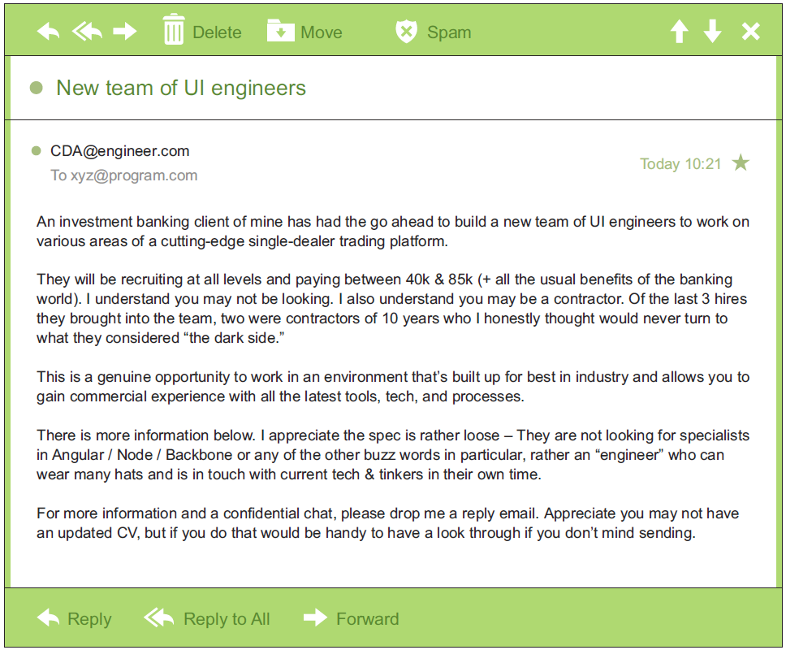
Unstructured Data
Unstructured data is data that isn’t easy to fit into a data model because the content is context-specific or varying
Could contain structured elements:
sender
title
body text
…
D. Cielen, A. D. B. Meysman, M. Ali, Introducing Data Science, Manning, 2016.

Slide 46
Natural Language
Example: text in e-mails, letters, Tweets, blogs, scientific papers
Beware of “unnatural language” – language that is very specific to a domain, e.g. legal texts
Notes:
context dependent
sometimes not all so natural

Slide 47
„Unnatural Language“: Patent Claims
A method for scrolling through portions of a data set, said method comprising: receiving a number of units associated with a rotational user input; determining an acceleration factor pertaining to the rotational user input; modifying the number of units by the acceleration factor; determining a next portion of the data set based on the modified number of units; and presenting the next portion of the data set.
A method as recited in claim 1, wherein the data set pertains to a list of items, and the portions of the data set include one or more of the items.
A method as recited in claim 1, wherein the data set pertains to a media file, and the portions of the data set pertain to one or more sections of the media file.
A method as recited in claim 3, wherein the media file is an audio file.
A method as recited in claim 1, wherein the rotational user input is provided via a rotational input device.
…
Notes:
READ TOP 3 LINES – ASK IF ANYONE KNOWS WHAT IT IS.

Slide 48
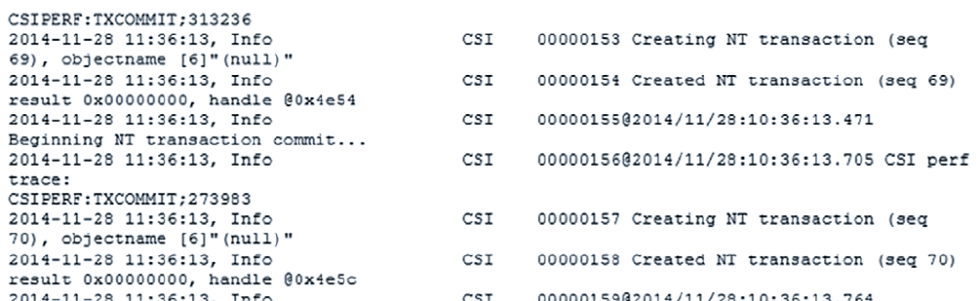
Machine-Generated Data
Information automatically created by a computer, process, application, or other machine without human intervention
Industrial Internet, Internet of Things, …
Usually high volume and speed
Examples: web server logs, call detail records, network event logs, and telemetry
Notes:
Event log

Slide 49
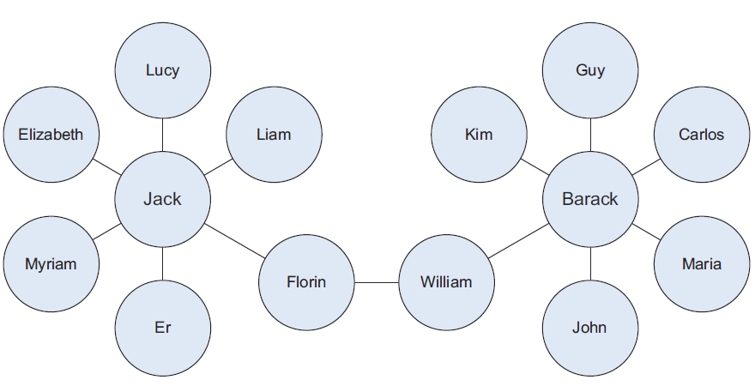
Graph-based Data
Graph-based data is a natural way to represent e.g. social networks: nodes, edges, weights
Its structure allows one to calculate specific metrics such as the influence of a person and the shortest path between two people
Overlapping graphs with the same nodes but different information in connections is powerful
Notes:
The power and
sophistication comes from multiple, overlapping graphs of the same nodes. For example,
imagine the connecting edges here to show “friends” on Facebook. Imagine
another graph with the same people which connects business colleagues via LinkedIn.
Imagine a third graph based on movie interests on Netflix. Overlapping the three
different-looking graphs makes more interesting questions possible.

Slide 50
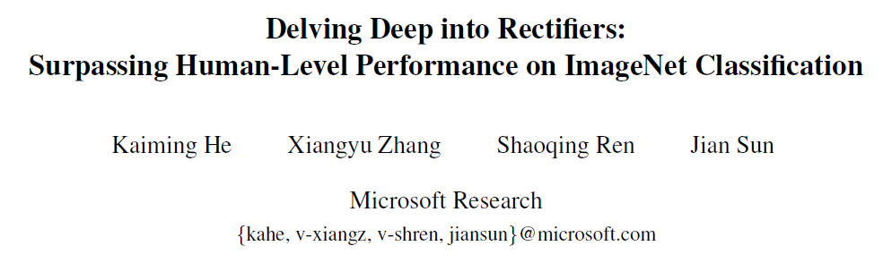
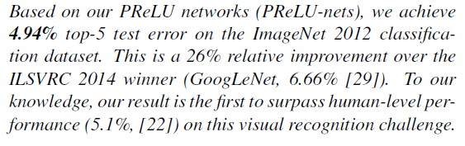
Audio, Video and Images
More complex to process than text data
Huge steps made recently in this area, in particular with deep learning
February 2015, http://arxiv.org/abs/1502.01852

Slide 51
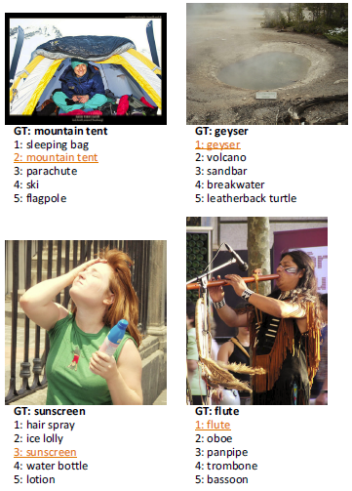
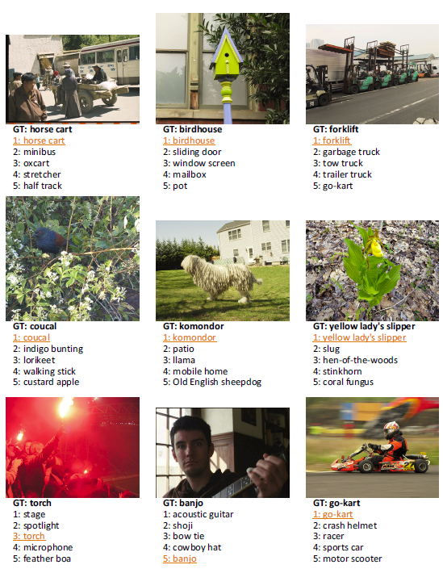
Notes:
(e.g., 120 species of dogs in the dataset). The second row of Figure 4 shows some example fine-grained objects successfully recognized by our method - “coucal”, “komondor”, and “yellow lady’s slipper”. While humans can easily recognize these objects as a bird, a dog, and a flower, it is nontrivial for most humans to tell their species.

Slide 52
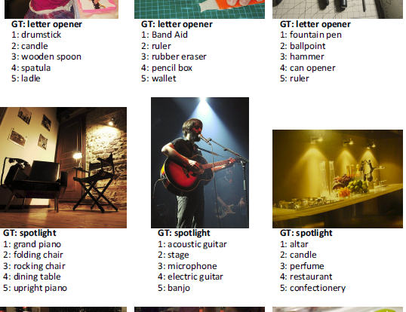
Notes:
On the negative side, our algorithm still makes mistakes in cases that are not difficult for humans, especially for those requiring context understanding or high-level knowledge(e.g., the “spotlight” images in Figure 5).

Slide 53

“On recognizing elementary object categories (i.e., common objects or concepts in daily lives) […], machines still have obvious errors in cases that are trivial for humans.”
February 2015, http://arxiv.org/abs/1502.01852

Slide 54
Streaming Data
Streaming data can take almost any of the previous forms
Streaming data flows into the system when an event happens instead of being loaded into a data store in a batch
Examples: “What’s trending” on Twitter, live sporting or music events, and the stock market

Slide 55
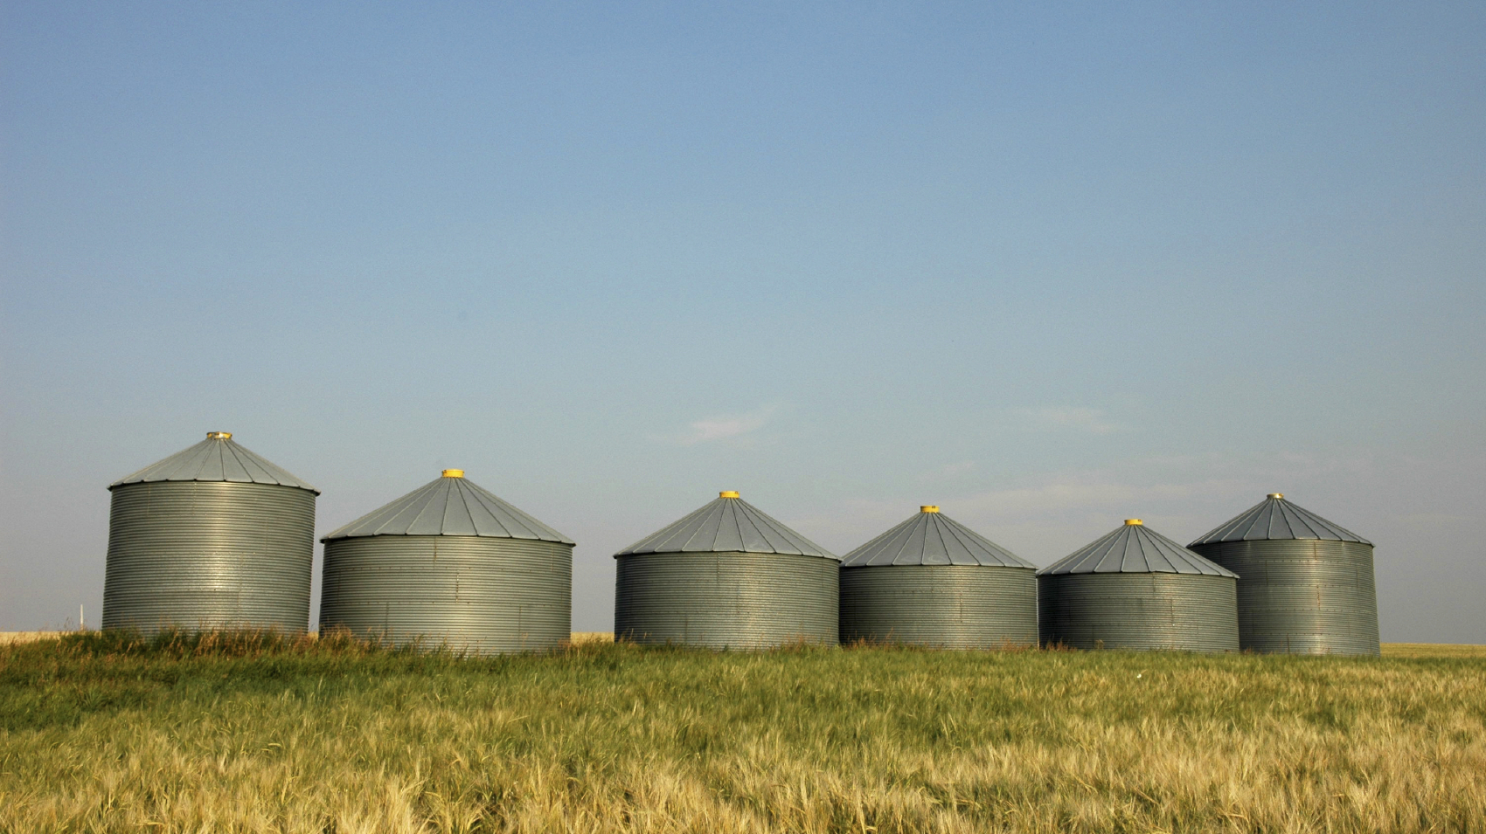
Can you get the data out of silos?
Accounting
Marketing
After-Sales Service
Customer Relations
Manufacturing
R&D
Notes:
Auch innerhalb einer Organisation wurde beim Aufbau der Informatik-Infrastruktur oft nicht daran gedacht, dass es später interessant sein könnte, Daten zusammenzubringen. Die Daten sind deshalb in voneinander getrennten Datensilos. Zum Beispiel in unterschiedlichen Abteilungen einer Firma. Aber das Nachverfolgen eines Produkts vom Designbrett bis zum Kunden braucht Daten aus vielen Abteilungen.

Slide 56
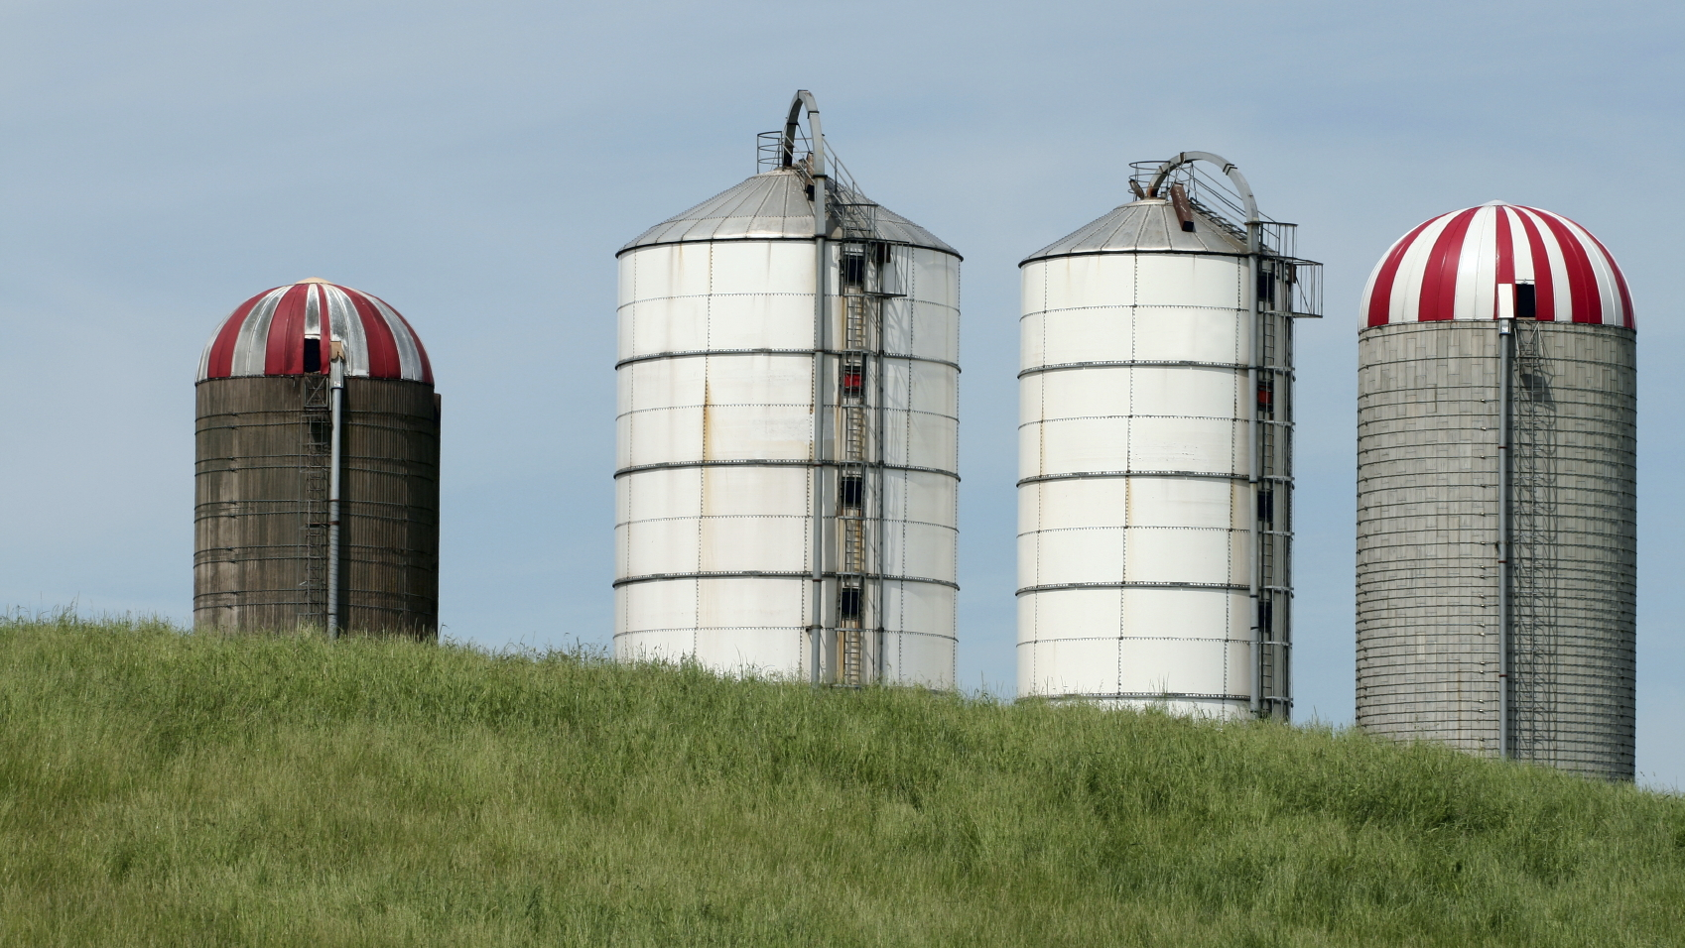
Outer Layer Fabrication Process
Tin Stripping
Connector Finishing
Inner Layer Fabrication Process
Notes:
Auch innerhalb einer einzigen Produktionshalle können in der Produktionskette unterschiedliche Maschinen die Daten über den Produktionsablauf „lokal“ speichern. Die Optimierung des ganzen Produktionsablaufs anhand dieser Daten ist dann schwer möglich.

Slide 57

Can you get the data?
Legal issues
Privacy issues
Notes:
Legal department says no.
Privacy laws – new General Data Protection Regulation. From May 2018.

Slide 58
Is the data suitable for answering the question and of sufficient quality?
Missing column headings
Data is not what is stated in the column headings
Missing values, Duplicates
Data from different sources with different time ranges
Anonymisation has removed necessary information

Slide 60
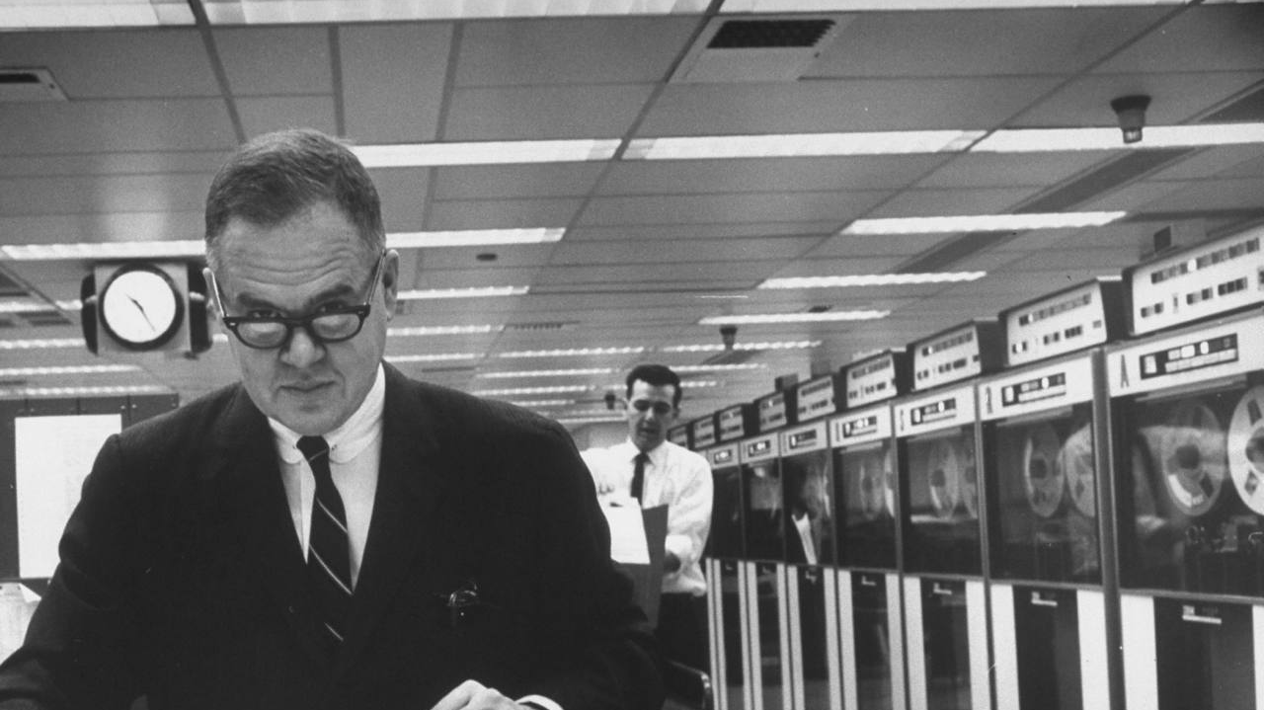
The data may not contain the answer. The combination of some data and an aching desire for an answer does not ensure that a reasonable answer can be extracted from a given body of data. John Tukey (1986)
Notes:
Es heißt data science mit gutem Grund: ein positives Ergebnis kann es auch sein herauszufinden, dass die gegebene Fragestellung sich nicht beantworten lässt

Slide 61
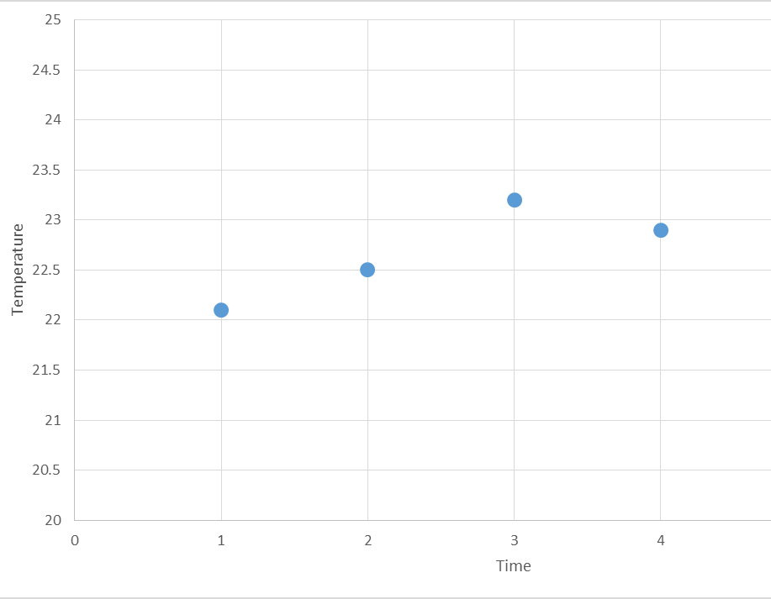
Do you understand the data fully?

Slide 62
Do you understand the data fully?

Slide 63
Do you understand the data fully?
Notes:
Telco busy hour
IT Systems load sampling

Slide 64
Abraham Wald the Missing Bullet Holes
https://medium.com/@penguinpress/an-excerpt-from-how-not-to-be-wrong-by-jordan-ellenberg-664e708cfc3d
Notes:
Sampling bias.
Wrong data

Slide 65
Sometimes data exploration is all you need
Example from astronomy in the years 1911-1913
Many characteristics of stars were measured or calculated:
Distance from the earth/sun
Brightness
Spectrum
Temperature
Chemical composition
…

Slide 66
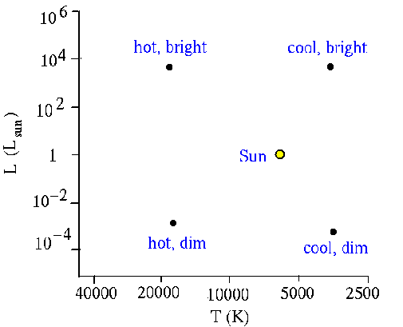
Hertzsprung (Leiden, 1911) and Russell (Princeton, 1913) had the idea to plot the brightness against the temperature for many stars:
http://cassfos02.ucsd.edu/public/tutorial/HR.html

Slide 67
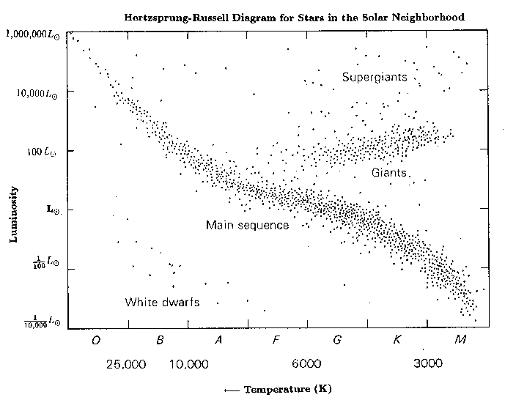
For stars close to the sun, they got the following result:
http://cassfos02.ucsd.edu/public/tutorial/HR.html

Slide 68
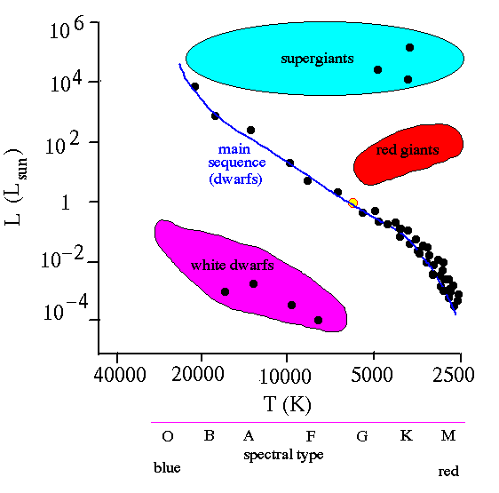
They saw 4 groups of star types

Slide 70
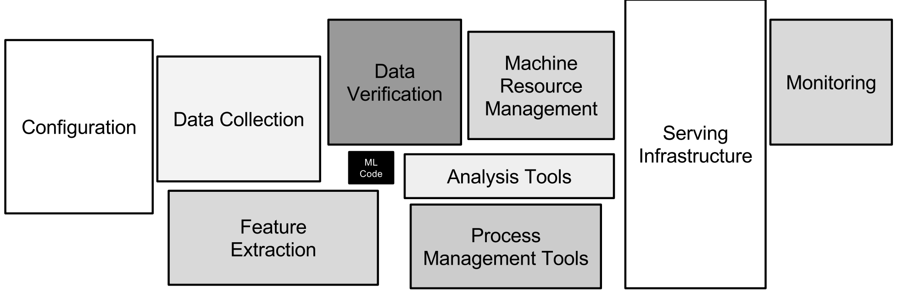
Notes:
Modeling is only a minmalistic small pater of the whole picture
We will return to this later on

Slide 71

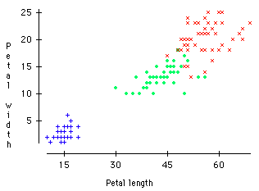
Classification
Classification is the problem of identifying to which of a set of categories a new observation belongs, on the basis of a training set of data containing observations whose category membership is known
Setosa
Versicolor
Verginica
http://dataaspirant.com/2017/01/25/svm-classifier-implemenation-python-scikit-learn/

Slide 72
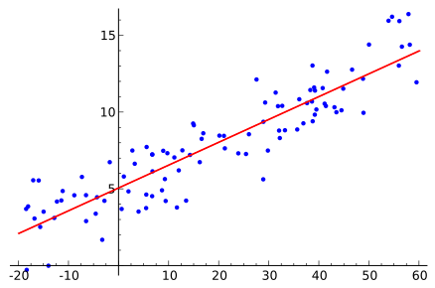
Regression
is the processes of estimating the relationships among variables. It includes many techniques for modeling and analyzing several variables, when the focus is on the relationship between a dependent variable and one or more independent variables (or 'predictors')
Notes:
Also talk about multidimensional, e.g. kriging

Slide 73
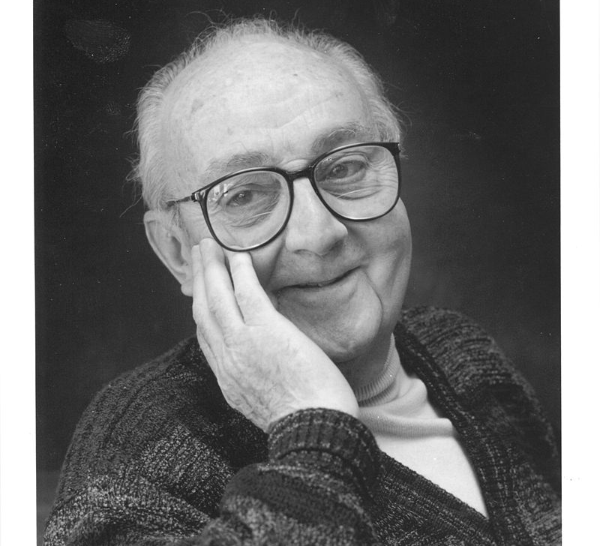
All models are wrong but some are useful
George E.P. Box, 1978
By DavidMCEddy at en.wikipedia, CC BY-SA 3. 0, https://commons.wikimedia.org/w/index.php?curid=14941622

Slide 74

Spherical Cows
By Ingrid Kallick (http://www.ikallick.com) - The image was created by Ingrid Kallick for the program cover of the 1996 annual meeting of the American Astronomical Association. An earlier version was created for the National Center for Supercomputing Applications. The artist gave permission for use to the University of Wisconsin Department of Astronomy. The STScI subsequently used the image. http://www.ikallick.com, Public Domain, https://commons.wikimedia.org/w/index.php?curid=3498985
Notes:
Netflix Preis,
Models only scientifc, not useful in reality
Milk production at a dairy farm was low, so the farmer wrote to the local university, asking for help from academia. A multidisciplinary team of professors was assembled, headed by a theoretical physicist, and two weeks of intensive on-site investigation took place. The scholars then returned to the university, notebooks crammed with data, where the task of writing the report was left to the team leader. Shortly thereafter the physicist returned to the farm, saying to the farmer, "I have the solution, but it works only in the case of spherical cows in a vacuum".

Slide 75
Fit the Model
How well the trained model fits the real world depends on:
The model selected
The data used for training
These are interdependent
A way of thinking about this is with Bias and Variance of the model
Notes:
ebenso wichtig wenn nicht mehr: Daten.
More data beats better algorithms
underfitting / overfitting

Slide 76

http://immersivemath.com/ila/index.html, https://github.com/fastai/numerical-linear-algebra/blob/master/README.md
https://textbooks.math.gatech.edu/ila/
Notes:
Repeat / revise missing math

Slide 77
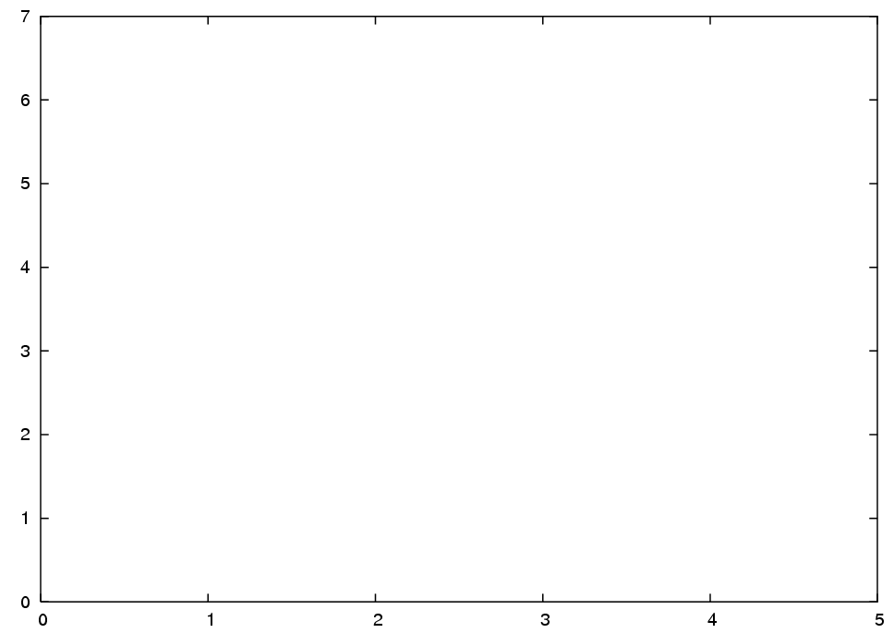
Bias and Variance for Regression
The (unknown) function that we are trying to estimate is F(x)
F(x)

Slide 78
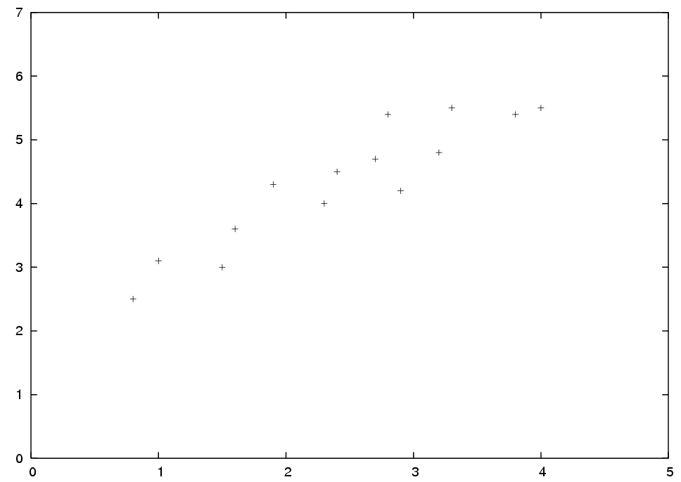
Regression
We estimate F(x) using a set D of n samples
D : n = 14

Slide 79
Regression
The estimated function is written as g(x; D)
F(x)
g(x; D)
It is interesting how g(x; D) depends on the training set D.
It could be that the estimation is very good for some training sets, but bad for other training sets with the same number of points

Slide 80
Example
Function F
With this training set one could get a reasonable estimate
x
Not with this training set

Slide 81
Bias and Variance for Classification
For classification, the boundary bias is usually used
It measures how well the decision boundary separates the classes

Slide 82
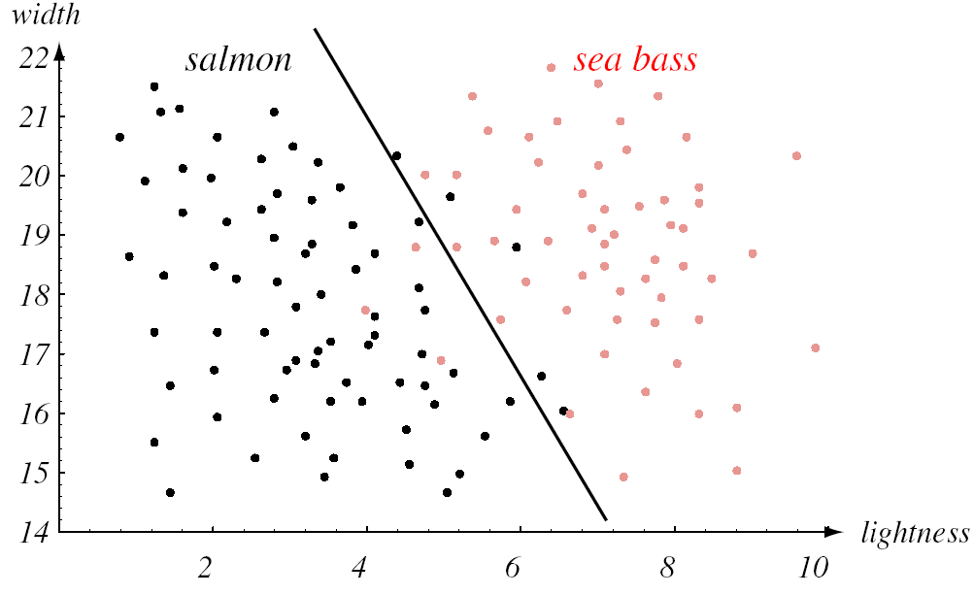
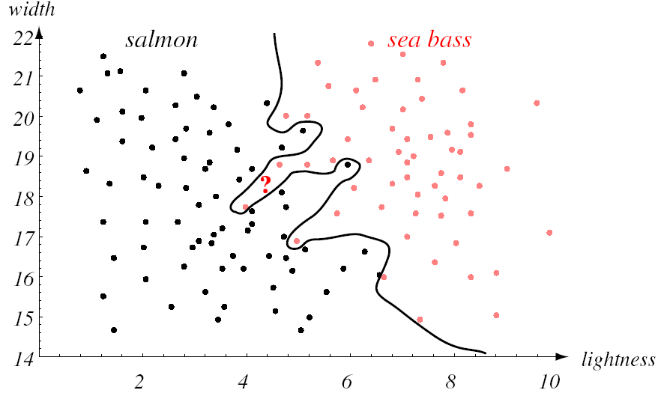
Bias high (underfitting)
Variance high (overfitting)
(Aus Duda, Hart, Stork: Pattern Classification, 2nd ed.)
Notes:
Self driving Car and people with darker skin are currently more likely to be run over
https://www.vox.com/future-perfect/2019/3/5/18251924/self-driving-car-racial-bias-study-autonomous-vehicle-dark-skin

Slide 83
Self driving Car and people with darker skin are currently more likely to be run over
https://www.vox.com/future-perfect/2019/3/5/18251924/self-driving-car-racial-bias-study-autonomous-vehicle-dark-skin

Slide 84
Summary
Bias
High for a model that is too simple or inflexible
Variance
High for a model that is too flexible with respect to the training data
Bias and Variance are not independent of each other

Slide 85
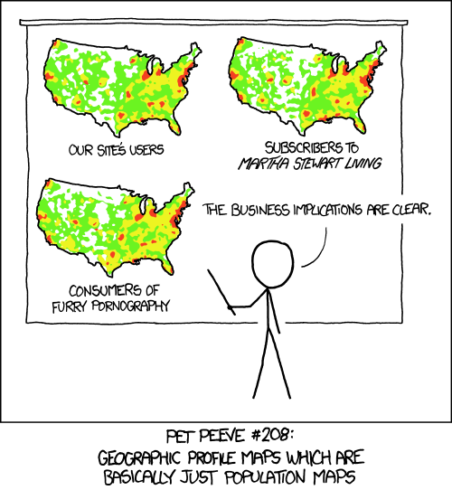
What is the real cause?
https://xkcd.com/1138/

Slide 87
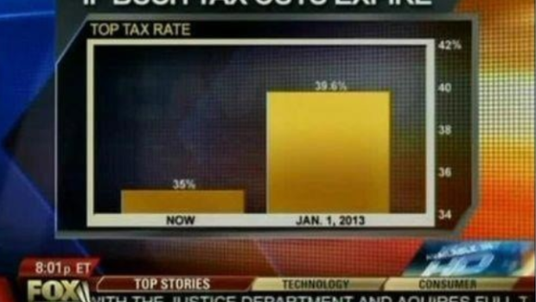
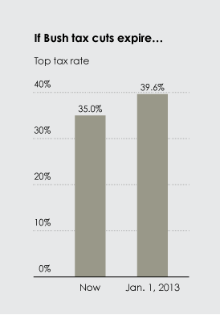
It’s easy to do a bad or misleading visualisation
http://flowingdata.com/2012/08/06/fox-news-continues-charting-excellence/
Notes:
Data Scientists want to sell their results to the business

Slide 88
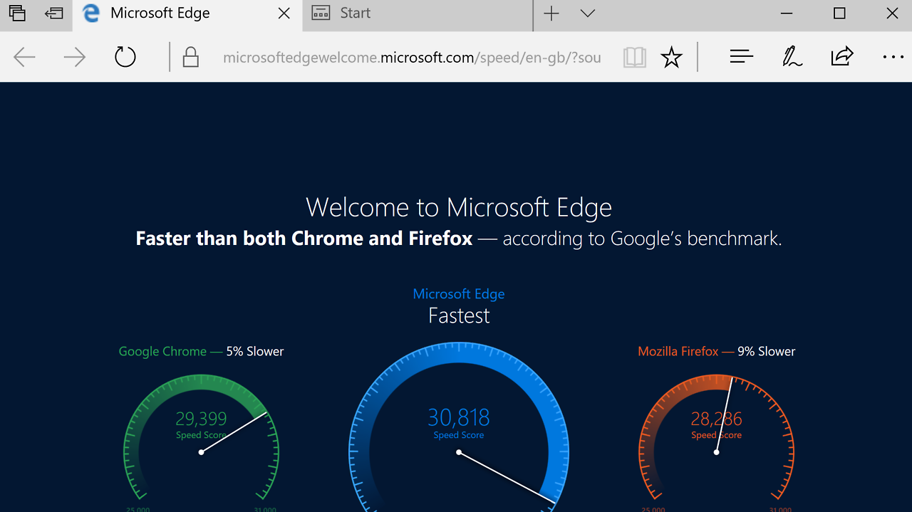
http://viz.wtf/

Slide 89

http://viz.wtf/

Slide 90

Caveats
https://www.data-to-viz.com/caveats.html

Slide 91
Notes:
Iterative Nature,
Agile!!!

Slide 92
Summary

Slide 93

What’s Hard about Data Science? (1)
Getting the data (usually)
Overcoming assumptions
Communication:
with domain experts
expectation management for client
https://xkcd.com/1831/
Notes:
Quote from paper “I’d rather the data go away than be wrong and not know”
Assumptions not communicated: transformations not documented.

Slide 94

What’s Hard about Data Science? (2)
Making ad-hoc explanations of data patterns
Overgeneralizing
Not checking enough (validate models, data pipeline integrity, etc.)
Using statistical tests correctly
Prototype → Production transitions
Data pipeline complexity (team boundary)
https://xkcd.com/1838/

Slide 95
Basics
GIT

Slide 96
What is it?
distributed version control
needed to keep a log of changes and synchronize across the team
See the demo and try it online
great and free GUI
https://www.sourcetreeapp.com/
Visual studio code
Notes:
Open the link https://learngitbranching.js.org/?demo

Slide 97

Git flow

Slide 98


Slide 99
DEMO
Please all follow along to https://github.com/lecturing/DHBW19-DS101-git-demo.git
Notes:
initialize repository. |||||||||| check time, ask who already knows
commit things
merge and branch
resolve conflicts

Slide 100
Basics
Conda virtual environments

Slide 101
Separate dependencies for each python project
conda create -n myenv python=3.7 scipy=0.15.0 astroid babel
conda env export | grep -v "^prefix: " > environment.yml
conda env create -f environment.yml
Documentation https://docs.conda.io/projects/conda/en/latest/user-guide/tasks/manage-environments.html
Notes:
Separat entwickeln
Teilen / versionskontrolle
Installation auf anderem System

Slide 102

Docker
Container
Notes:
Alternatives have developed https://containerjournal.com/topics/container-ecosystems/5-container-alternatives-to-docker/

Slide 103
Compartmentize complete operating systems
like a virtual machine with less resources
similar to a cookbook recipe
not only allows to have reproducible conda environments and versions but complete environment (native dependencies, compiler, settings, ….)
docker-compose / K8S for orchestration
Notes:
Explain orchestration
Declarative how many instances are running and connected to what else (app -> DB), name, DNS, IP

Slide 104

docker

Slide 105
DEMO
Start your docker daemon & follow along
Notes:
Jupyter notebook with postgres example
1. install docker desktop https://www.docker.com/products/docker-desktop
2. install git
- https://git-scm.com/
- on OsX using homebrew: `brew install git`
2. clone the repository by executing: `git clone https://github.com/lecturing/DHBW19-DS101.git`
3. go inside the `labs` folder and pull the prepared images by executing: `docker-compose up`
4. got to the web UI of the jupyter notebook

Slide 106
Basics
SQL & Relational Algebra
Notes:
Almost all Systems storing Data speak some dialect of SQL

Slide 107

Turing complete SQL - fractals
new versions of SQL offer more than only relational algebra operations
https://malisper.me/generating-fractals-with-postgres-escape-time-fractals/
Notes:
But not quite – first, let‘s look at a simple database

Slide 108

THE simplest database
A key value store
Notes:
Store things
Get it back
Store new things
Key – value store

Slide 109

THE simplest database
Store and query
Overwrite

Slide 110

THE simplest database
What is stored inside?
Properties of this data store:
Fast write (append to file, log structure)
Slow read (full table scan to find most recent version of key)
No cleanup /compaction of overwritten records
Notes:
db_set append to file very fast. Like Log Datastructure used frequently
db_get full table scan O(n)
Mitigated with an index (basically this is **the real DB** ;) )

Slide 111


Difference to real world databaases
Log, like in the simple example plus:
Concurrency handling
Resource cleanup, compaction
Error handling for partially written records
Index
Declarative query language
Notes:
WAL write ahead log

Slide 112
sample data
CREATE TABLE test (
id INT,
foo TEXT
);
INSERT INTO test (id, foo) VALUES (1, "first");
INSERT INTO test (id, foo) VALUES (2, "second");
https://www.db-fiddle.com/
https://dataschool.com/learn-sql/ is a great resource for learning

Slide 113

projection Π
select columns
SQL: SELECT foo FROM test;

Slide 114

Selection σ
filter rows
SQL: SELECT * FROM test WHERE id = 1;

Slide 115

Join ⋈ (natural)
combine tables on condition
SQL: SELECT * FROM table1 t1, table2 t2 ON t1.name = t2.name;

Slide 116

many join variants
https://en.wikipedia.org/wiki/Relational_algebra different JOIN types

Slide 117
groupings
perform aggregation (min, mean, …) per group
SELECT column_name(s)
FROM table_name
WHERE condition
GROUP BY column_name(s)
ORDER BY column_name(s);

Slide 118

common table expressions
define reusable SQL snippets; watch out for the optimizer

Slide 119

window functions

Slide 120
Basics
Regex (regular expressions)

Slide 121

matching text (regex)
useful for data cleaning
data filtering (wildcards)
most databases also support regexes in SQL
https://regex101.com/r/kK4bD6/1

Slide 122
Basics
unix

Slide 123
Reproducible = repeatable = automated = scripts = terminal (regardless of OS, linux will be discussed)
http://www.informit.com/blogs/blog.aspx?uk=The-10-Most-Important-Linux-Commands
ls
cd
man
mkdir
rm
locate
Commandline text editor vim /emancs (when working on remote servers)
Data science in the shell https://blog.robertelder.org/data-science-linux-command-line/
Notes:
Open up link for DS in shell

Slide 124
Hands on data cleaning and ML
Part 2

Slide 125
Datascience lifecycle
crispdm

Slide 126
Ask
Define objectives
Identify data sources
Notes:
Make sure the objectives are measurable. You need to use them as a loss function son
Batch or online evaluation?
Second one is harder than it looks like

Slide 127
Data acquisition example
legacy systems store the data
Data quality and timeliness is an issue
No single source of truth
Extensive data cleaning

Slide 128

Notes:
outsourcing
loss oof knowhow
no governance
Different department / country

Slide 129
Get
Overcome silos
Convince stakeholders to get access
Understand preprocessing pipeline
Notes:
Want to look at potential (marketing) but only part of the data is actually collected

Slide 130


Slide 131
SQL is your friend – if you use it in the right (modularized) way
Notes:
You might be lucky and already have data in a well maintained database
Most people / enterprises are not
Mastering SQL is very helpful and flexible
But handle it like an engineer not a scientist
Build reusable modules

Slide 132
https://chartio.com/blog/cloud-data-management-book-launch/
Notes:
Do your modeling as new schemas of views in SQL—either with your own files, or using a great framework like dbt.
Don’t use a proprietary third party modeling language; this is all best done in SQL. It’s powerful, performant, vendor agnostic, and your team already knows it.
Don’t overthink your modeling by reading too many books on dimensional modeling by legends like Inman or Kimball. The majority of the books out there are decades old, and as I described above, the best practices then were based on completely different technology considerations.

Slide 133
3 Vs of Data
Volume
Terabytes
Records
Transactions
Tables
Files
3 Vs of Data
Velocity
Batch
Near Time
Real Time
Streams
Variety
Structured
Unstructured
Semistructures
All the above
Source: IBM
Notes:
[moa]
Volume
What is the amount of data?
Bytes, MB, GB, TB, PB?
How many rows, transactions are involved?
How many tables, attributes, etc. are involved?
Take care when calculating the amount of data. Small records still consume PT of data when stored every second for thousands of sensors.
Variety
Structured (“tidy”)
Fully structured data follows a predefined schema
Tabular data stored in a RDBMS
Semi-Structured (“untidy”)
Semi-structured data is often explained as "...schemaless or self-describing, terms that indicate that there is no separate description of the type or structure of the data”. Semi-structured data does not require a schema definition. This does not mean that the definition of a schema is not possible, it is rather optional.
One of the strengths of semi-structured data is that it can accommodate variations in structure. But this flexibility makes it difficult to consume as-is without further tweaking and tidying by client applications.
Un-Structured (“messy”)
Videos, Images, Large Texts, Archives (zip),…
Unstructured data can also described as data that cannot be stored in rows and columns in a relational database, i.e. non-tabular.
Velocity
How recent is the data?
Changes it once a year or even less often? E.g. election results.
How recent does the data need to be?
Once a day? E.g. Create a new offer for a customer segment?
Once every hour? E.g. I need to see activities during the day. (Traffic)
(Near) real time? E.g. I need to identify fraudulent activities to prevent cost explosion. (SIM-Boxes)
How is the data loaded?
Batch: Schedule the loading on a fixed time basis
Near, Real time? Decrease the batch time.
Streaming: Let the data come to you (Listener)

Slide 134
3 Vs of Data | volume
What is the amount of data?
Bytes, MB, GB, TB, PB?
How many rows, transactions are involved?
How many tables, attributes, etc. are involved?
Take care when calculating the amount of data. Small records still consume PT of data when stored every second for thousands of sensors.

Slide 135
3 Vs of Data | Variety
Structured (“tidy”)
Fully structured data follows a predefined schema
Tabular data stored in a RDBMS
Semi-Structured (“untidy”)
Semi-structured data is often explained as "...schemaless or self-describing, terms that indicate that there is no separate description of the type or structure of the data”
Un-Structured (“messy”)
Videos, Images, Large Texts, Archives (zip),…
Notes:
[moa]
Semi-structured data does not require a schema definition. This does not mean that the definition of a schema is not possible, it is rather optional.
One of the strengths of semi-structured data is that it can accommodate variations in structure. But this flexibility makes it difficult to consume as-is without further tweaking and tidying by client applications.
Unstructured data can also described as data that cannot be stored in rows and columns in a relational database, i.e. non-tabular.

Slide 136
3 Vs of Data | Velocity
How recent is the data?
Changes it once a year or even less often? E.g. election results.
How recent does the data need to be?
Once a day? E.g. Create a new offer for a customer segment?
Once every hour? E.g. I need to see activities during the day. (Traffic)
(Near) real time? E.g. I need to identify fraudulent activities to prevent cost explosion. (SIM-Boxes)
How is the data loaded?
Batch: Schedule the loading on a fixed time basis
Near, Real time? Decrease the batch time.
Streaming: Let the data come to you (Listener)
Notes:
[moa]

Slide 137




Two Types of Universe: Our Universe and the „Tidyverse“
Attributes
Chaos Entropy Disorder
Observations
The Rules of the Tidyverse
Each variable must have its own column.
Each observation must have its own row.
Each value must have its own cell.
Notes:
[anp]
Normally, data chaos reigns and creeps with each passing day and it will continue to do so, unless we act against it to impose and maintain some order.
The tidyverse is a R package, available at https://github.com/tidyverse/tidyverse
If you are a serious data scientist, R will be your Swiss army knife and the tidyverse package will be indispensable in taming and tidying the data sets that you want to explore.
We organise (order) atomic data points (qualitative and quantitative variables) into “tabular data”, collections of attributes or entities which we then observe. These observations constitute the members of our data sets.
The number of columns (attributes) per entity is fixed. The number of rows (observations) can vary. Each row is a unique combination of attribute values, in particular the subset of attributes which form the candidate primary key.
Other terms for column: field, property, attribute, variable, parameter
Other terms for row: tuple, record, vector
The intersection of row and column is a cell
Qualitative (nominal) and quantitative (numerical) attribute variables but also missing values can be observed and put in the right place. These attributes are facts about a particular member instance of a class entity.
In RDBMs the most efficient form of tabular data storage is 3NF where redundancy is eliminated and referential integrity between relations (tables) is ensured by making sure that attributes depend on the (entire) primary candidate key of each row and not on some (subset) of non-PK attributes.
A table is a generalised, efficient and compact format for conveying information

Slide 138
Metadata - Using Data to Manage Data
Technical
System/Owner
Date/Time Zone
Business
Name, Definition
Process
ETL Job ID
Quality Checks
Record Count
Encoding, Format
Translations
Search Tags
User Comments
Related Items
Scheduling
Data Profile
Dependencies
Notes:
[anp]
Technical metadata is mostly hidden from end users and is often supplied by source systems to provide a „frictionless“ data ingestion process which maps sources to staging base tables. This can include details about source system, export date/time and time zone, encoding, data file format, field layout and data types, number of records, ETL job.
Other technical metadata within the DWH can include configuration and transformation rules when importing, filtering and aggregating the data source.
Business metadata is supplied mostly by end users, whatever helps them to understand, find and share the data such as data definitions, descriptions, translations, alternative names, related items and so on.
Process metadata is used to configure and log ETL processes, e.g. ETL job dependencies, scheduling and chaining of scripts, keeping an audit trail and data lineage details, error logs, triggering notifications and alerts according to specified events or threshold values.

Slide 139
Metadata - Using Data to Manage Data
Metadata Repository
Data Sources & Extraction
Presentation & Collaboration
Sources
Staging
Subscribers
Storage & Transformation
Technical
Business
https://towardsdatascience.com/how-linkedin-uber-lyft-airbnb-and-netflix-are-solving-data-management-and-discovery-for-machine-9b79ee9184bb
Notes:
[anp]
Broadly speaking, we can say that metadata should assist in the discovery, use and interpretation of data, providing a frame of reference and inputs for metadata-aware reporting services and software which support end users in monitoring and analysis as well as sharing their findings with others in a collaborative fashion.
An approach which combines quantity (breadth of coverage) AND quality (use of standards) is the key to building a solid metadata repository.
When first setting out to brainstorm on the kinds of metadata you could collect, don‘t focus narrowly on the front-end or user experience. Work out what metadata will help you to influence the back-end retrieval and aggregation of data. Adopt a back-to-front perspective, documenting what metadata will prove useful in propagating, preserving, standardising and securing information through the BI chain from backend to frontend.
Business metadata reaches out to the end-user and makes data more easily consumable, that is, understandable and intelligible, metadata facilitates interpretation, analysis, collaboration. In this respect metadata really does extend the reach of BI and puts BI end users in the driver’s seat by helping them to get to grips with their data.
Technical metadata is more than just the database‘s data dictionary: it documents data formats (import/export interfaces), data provenance, lineage and stewardship responsibilities, data security levels, securing sensitive data, enforcing calculation rules, configuring infrastructure services that support data preparation routines, e.g. Thresholds for alerts.
Metadata can be exploited to support the technical, business and administrative processes that move data from A to B
The metadata helps us to “join the dots” from the data sources right through to the data sinks (subscribers).
https://towardsdatascience.com/how-linkedin-uber-lyft-airbnb-and-netflix-are-solving-data-management-and-discovery-for-machine-9b79ee9184bb

Slide 140
Take Aways from The Data Kitchen
DATA ≠ INFORMATION
Good data is only valuable if it is the right data for your purposes
TIDY DATA is a key asset for any analytical activities
METADATA is also a valuable type of data
Data Scientists don’t have to be Data Engineers…but it is good to know what Data Engineering entails and to be able to help out in the data kitchen, when trained staff are in short supply!
Notes:
Get business users to spell out in as much detail as possible what data they want. What kinds of questions do they want answers to? What keeps them awake at night?!

Slide 141
prepare
Cleanup
Feature generation
enrichment
Notes:
Get creative!
Your turn.

Slide 142
Your turn - LAB 1
Validate dependencies
Start jupyter notebooks
Initial load of data
Data cleanup
Basic summary statistics
Notes:
Selection of the dataset has already been taken care of.
Still, there is enough work left.
Begin with Introduction to python
Add basic web scraping as well

Slide 143

Notes:
Further learning experience

Slide 144

Show me your code and conceal your data structures, and I shall continue to be mystified. Show me your data structures, and I won't usually need your code. -- Fred Brooks --
Notes:
this paradigm still applies particularly for data heavy applications.
Especially when documenting them

Slide 145
Modelling
The fun part (20%)
Beware of automation (featuretools, hyper parameter tuning, selection of a model)
Notes:
Get creative!
Your turn.

Slide 146
Notes:
Wie gut funktioniert die Methoden?
Hier ein Beispiel, wie das gemessen wird. Nehmen an wir suchen Terroristen / Non-payer

Slide 147
Notes:
Die Figuren mit viereckigen Körper sind die Terroristen.
Wir wissen das nicht, und wollen sie detektieren.

Slide 148
Notes:
Für die einfachheit der Darstellung, habe ich alle Terroristen jetzt oben links platziert.

Slide 149
Notes:
Unser Terroristen-Erkennungs-Algorithmen or –Methode prognostiziert, dass die rote Figuren Terroristen sind.

Slide 150
TP
FP
TN
Notes:
Diese nicht-Terroristen werden richtig prognostiziert – passt
Auch diese 5 Terroristen werden richtig erkannt – in ordnung
Aber 2 Arten von Fehlern werden gemacht. Diese Figuren sind nicht-Terroristen, die als Terroristen klassifiziert werden.

Slide 151
TP
TP
Precision =
FP
TP
+
FP
TN
Notes:
Dieser Fehler wird mit „Precision“ gemessen
Anzahl richtig detektierte Terroristen durch die Summe von den richtig und falsch detektierte Terroristen. 5/15=1/3
Wie viele von den detektierten Terroristen sind wirklich Terroristen? Nur 1/3 der Prognosen sind richtig.

Slide 152
TP
FN
FP
TN
TP
TP
Precision =
Recall =
TP
+
FP
TP
+
FN
Notes:
2. Art von Fehler sind die Terroristen, die als nicht-Terroristen erkannt werden.
Ein schwere Fehler in diesem Fall
Wird durch „Recall“ gemessen –Anzahl richtig erkannt durch die Summe von richtig und nicht-erkannten Terroristen: 5/10=1/2
Nur 50% von den Terroristen die zu detektieren sind, sind detektiert worden.
Wenn Recall steigt, wird Precision niedriger – mehr Terroristen richtig detektiert -> mehr nicht-Terroristen falsch detektiert. Wird konsequent im Flughafensicherheits-Fall umgesetzt.

Slide 153
data trainer - choosing the right evaluation function
you are no longer a programmer but a trainer
train for the right outcome
understand business needs
use fitting metric. Be aware of imbalanced datasets; accuracy will be misleading
spend time for high quality
training data. Understand the full data processing pipeline E2E
labels (if supervised algorithm)
if labels are hard or expensive to obtain, try to reformulate it into an unsupervised problem.

Slide 154



Finnish (also gender neutral):

Slide 155

https://nextshark.com/chinas-wechat-fire-translating-black-foreigner-n-word/

Slide 156

reformulating to anomaly detection - example

Slide 157


Slide 158


Slide 159

Choosing a evaluation metric
Tailor it to the business need
Potentially handle imbalanced data
Precision easily is about 100% in imbalanced case if majority class is predicted always
Are all classes equally important?

Slide 160


evaluating fitness of a model
statistics
cross validation
split data sets, but consider:
ordering of records
time
business application

Slide 161

hyper parameter optimization (randomly trying things)
most models perform poorly if its parameters are non optimal
grid search
random search
bayesian optimization (http://hyperopt.github.io/hyperopt/, https://sigopt.com/, https://github.com/scikit-optimize/scikit-optimize)

Slide 162
Preprocessing!
there always is certain domain knowledge. Adding this will greatly help the algorithm
for some, numeric features must be scaled
log
min-max, standardize, …
handling of categorical (string) data. Ordering? Dummy coding? Contrast Coding?
the power of preprocessing is underestimated
spend more time here, the rest will be automated anyways (soon)
in fact: featuretools automates some basic features already
autoML: https://sigopt.com/, https://github.com/hyperopt/hyperopt, https://epistasislab.github.io/tpot/ and https://www.h2o.ai/products/h2o-driverless-ai/

Slide 163

Areas of Machine Learning / common models
Notes:
linear regression; variants which do not have matrix inversion problem: LASSO, elastic net
Tree based models: decision tree, random forest, gradient boosted trees (xgboost, lightgbm, catboost, h2o gbt)
anomaly detection, mean shift, autoencoder,
deep learning, dbscan, kmeans, hdbscan, ...

Slide 164
Misconceptions by corporate IT
development has no access to production data
without data there is no machine learning
evaluate anonymization strategies per use-case
development has no large requirements for hardware
training a deep learning model or searching for the best parameters is very resource intensive
in fact more resources are required to build (train) the model in development than to score (run/evaluate) it in a production setting
the project is done after deploying the initial model
NO, the journey just starts there: updating the model and validating it still produces the correct outputs requires manpower

Slide 165

Agile & Iterative nature - CRISP-DM
first work on E2E workflow (even if predictions are useless)
then improve predictions
always evaluate a minimal baseline like a dummy classifier
Notes:
Gain quick feedback if the thing you are building is actually useful for the business

Slide 166
Your turn - LAB 2
Training models
Comparing results
hyper parameter tuning
model explanation

Slide 167
Live evaluation
Basic testing already completed after cross-validation
Test it for real
Beware of side effects, look at overall ROI
Notes:
Deliberately renamed.
Obviously Cross-validation is part of it.
But doing an E2E evaluation is critical.

Slide 168
Things get serious now
You might kill people (if you are the NSA)
Value is only created when others can use it - build an API
Do not underestimate the importance of data governance
Invest in reautomation
Hidden Technical Debt in Machine Learning Systems
Notes:
Importance of other things around ML
Hopefully you have an integrated API available early on (so IT can start to integrate as soon as possible)
That is totally ok to use a dummy classifier at first until the final model is ready.
It is well worth having an E2E pipeline in place where other stakeholders can easily use the results than having an excellent model (and noone consumes it)

Slide 169

https://www.youtube.com/watch?v=K0hg6o9MWKQ

Slide 170

Process of trial and error – bring structure to it
Notes:
Will be revisited later in the lab and also in the next part about model deployment and automation.
Scaling projects means standardizing, making results reproducible and runnable in any environment

Slide 171
model deployment & governance
an awesome model on your computer is useless if the business or your colleagues cannot use it.
transform it into an API
make the process of deploying a retrained model streamlined & reproducible (https://mlflow.org/, docker) and record which parameters lead to which outcome (legal audit, improvement of models)
try to not reinvent the wheel. There are many model deployment tools. Choose a fitting one. Do not recode from scratch in C++/java for no reason ; )

Slide 172
Your turn - LAB 3
Build an API
Workflow Automation

Slide 173
Big data
outlook

Slide 174

https://dataintensive.net
Notes:
But also requirements have risen drastically:
Reliability
Scalability
Maitainability
When working in the enterprise and comparing in-house applications with web scale services …
standard building blocks partially ease the burden thanks to open source
many applications need to:
- Store data (databases)
- Remember the result of an expensive operation, to speed up reads (caches)
- search data by keyword or filter it in various ways (search indexes)
- Send a message to another process, to be handled asynchronously (stream processing)
- Periodically crunch a large amount of accumulated data (batch processing)
BUT:
not simple to choose the right ones, different characteristics for each use case
This is why so many different data bases and data processing tools have developed
Hopefully after this talk choosing the right components is a bit easier for you

Slide 175

limitations of classical RDBMS
scalability scale up only
https://www.syslink-xandria.com/blog/scaling-up-vs-scaling-out-sap-on-the-public-cloud
Notes:
Internet comapnies (yahoo, google) started to index the web
Scaling up or out
Licensing for scaled out commercial RDBMS
Bound to single always larger servers but write IO load was too large, and availability too low

Slide 176
limitations of classical RDBMS
scalability
scale up only
fault tolerance / high availability
latency
consistency (single leader replication)
write throughput (single leader replication)
analytical queries (workaround: data warehouse)
Notes:
Global multi data center availability

Slide 177

Notes:
But the hardware has changed and not all big data vendors have this reflect in their big marketing campaings.

Slide 178
…should rather be 5
fits in one machine (TB of ram are cheap)
raw data is too large for memory of single computer; aggregation allows for analysis on single computer
data is really too big for a single machine and aggregation not helpful (distributed ML)
connection of (small) data silos (enterprise)
fast data (streaming big data analytics)
Notes:
1 –
2 aggregation performed either out of core or cluster
3 go distriburted
4 enterprise style. Linear regressions ; ) and lots of data cleaning and stakeholder management
5 -

Slide 179

Apache Hadoop
https://www.syslink-xandria.com/blog/scaling-up-vs-scaling-out-sap-on-the-public-cloud
Notes:
Internet scale indexing of websites (yahoo, google)
map reduce
goal: parallelize only business domain
No networking
No retry / fault tolerance
No concurrency
Foxus on what needs to get done
Same code on small and petabyt scale of data
Previous solutions required manual handling of sophisticated problems to achieve fault tolerant applications

Slide 180

Map-Reduce paradigm
http://blog.sqlauthority.com
Notes:
similar to mergesort -> illustrate with word count example
note: function should be commutative and associative as data is exchanged over the network
communtative: order of operations must be irrelevant, no deterministic ordering after network shuffle
Associative: push down predicates to decrease shuffle and improve performance
Data written to disk on each step. Very reliable and slow
But framework takes care of hard things (reliability, retrying, network communications, delays)

Slide 181

Hadoop Distributed File System

Slide 182

Notes:
The ecosystem has grown massively
A lot of vendors want to have a part of it
Recently there was a strong movement to managed cloud-hosted environments
- Simpliity of hosting
big data is like mainframe spaghetti code on steroids. The good think it is with less goto and in java
but the full advantages only show when separating compute and storage and automating everything

Slide 183

Notes:
in general they fall into these categories
Some data is also processed in streams

Slide 184

Steaming needs to handle late arriving events
Notes:
A look at fast data
But opens up new problems: event time vs. Processing time
Classic way to handle: lambda architecture fast and slow layer:
-- complexity

Slide 185

Tools evolve constantly. Unified API for batch & streaming
Notes:
Tools evolve constantly. Especially in big data
Increasingly unified API for batch and streaming: no lambda (batch layer & fast layer) but streamlined kappa architecture
Previous architectures required two paths:
Offline processing of complex ML
Online serving
Complexity is no longer necessary.
Prevents inconsistencies
Reusable code

Slide 186


Slide 187
loss of convenience
CREATE INDEX missing
Deep understanding of underlying technologies required
Many knobs to turn (allows you to optimize for the use case)
No total ordering when shuffling
use case specific data marts (in possibly different database technologies) possible
Notes:
True for both batch & streaming
The classic RDBMS in either mode OLAP / OLTP was very simple and convenient but had ist limitations.
New world, in OLAP: hadoop looses a lot of convenience due to distributed naturE
Vendors aRE working hard to get back as much as possible (Hive 3: PL-SQL, UPERTS, ACID)
But gains more freedom to optimize for increasingly complex use cases

Slide 188
Future pROSPECTIVES

Slide 189
Hybrid cloud
run the same infrastructure on premise
and in (Multiple) cloud(S)
Notes:
Increasingly more systems run on non local environments.
Real cloud
Cloud like local
Sometimes ¾ of year spent waiting of a new machine in the enterprise
Automation
Use pay per use

Slide 190


DATA PIPELINES
https://cdn-images-1.medium.com/max/1600/1*fQ-njV3nWhQIOrxn9pMMVg.png
Notes:
This principle is driven to the extreme with serverless data pipelines
Pay per request
Automated scalability
No stepped fixed cost
But fairly expensive
Tight vendor lockin

Slide 191
A step back
- Into reality

Slide 192

Think! What your use case really requires
https://blog.bradfieldcs.com/you-are-not-google-84912cf44afb
Notes:
Developers
Especially large enterprises struggle
Dev / ops mismatch
People
Simple is better than complex

Slide 193
Think! What your use case really requires
Command-line Tools can be 235x Faster than Hadoop Cluster
big RAM is eating big data. Machine with 2-5 TB RAM are cheap
Notes:
large complexity of operating a distrubted system. Often, too complex for classical IT

Slide 194
If you need to brush up your CLI skills
https://blog.robertelder.org/data-science-linux-command-line/
Gives a great introduction to the tools available

Slide 195
classic RDBMS have caught up
postgresql (and plugins)
JSON
columnar layout
GPU accelerated queries
unified interface to multiple storage engines (hive)
time series database including partitioning (timescaleDB)
version 12 has increased support for parallel scans, aggregates and joins
MS SQL Server 2019 integrates spark to scale out analytical queries integrates tensorflow
Notes:
Hive support in postgres (unified)

Slide 196
unbundling databases
breadth, not depth
separation of code and state, compute & storage
Notes:
Giving flexibilitiy
Combining different databases to achive goood performance for a much wider range of workloads
Statless frontends and stateful databases ➔ subscribing to change just starting (flink queryable state)
Storage. / compute: k8s integration, workload flexibility

Slide 197
DataOps Manifesto
Individuals and interactions over processes and tools
Working analytics over comprehensive documentation
Customer collaboration over contract negotiation
Experimentation, iteration, and feedback over extensive upfront design
Cross-functional ownership of operations over siloed responsibilities
Notes:
For developers a lot changed in recent years with agile methodologies
In the data universe this has not yet taken up speed
Similar to agile manifesto ahs recently been developed

Slide 198
Summary
Invest in people & Automation
choose your tools wisely. going distributed should not be the first option.
Notes:
Be adaptive

Slide 199

Hardware has changed
big RAM is eating big data
new (research level frameworks) utilize modern hardware and scale out https://github.com/lsds/Saber
Notes:
but missing: mysql | elasticsearch continously pipe documents to ELK for indexing
big data is like mainframe spaghetti code on steroids. The good think it is with less goto and in java
but the full advantages only show when separating compute and storage and automating everything

Slide 200

computing on multiple nodes: limits of total ordering
expensive, must pass through single node (in most cases)
gigantic shuffle IO
approximative sketches can help
Notes:
https://datasketches.github.io/
https://github.com/isarn/isarn-sketches-spark

Slide 201
Analytical workloads
change data capture (stream)
ETL (batch)

